Slide 1

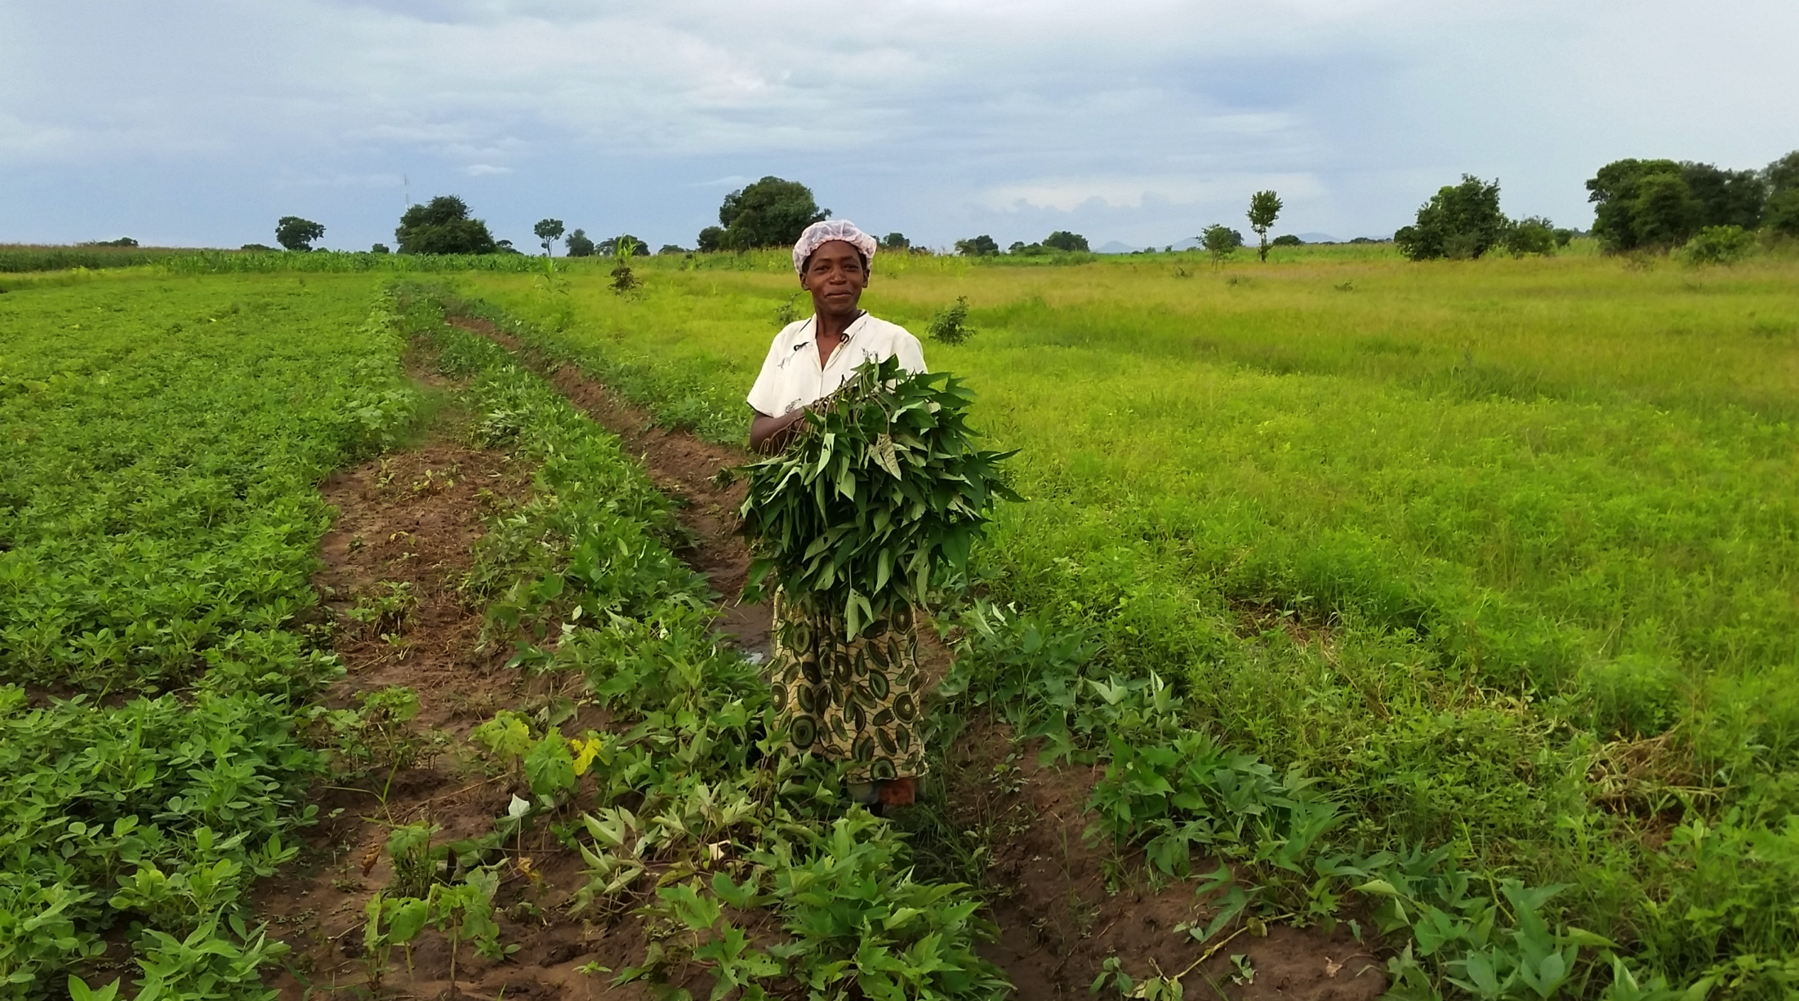
BUILDING SUSTAINABLE BREADBASKETS
Notes:
I want to talk today a bit about “Building Sustainable Breadbaskets” and how vital the role of new technologies, including precision agriculture and data systems, biotechnology and bio-innovation are to this urgent process. Global Harvest Initiative staff recently spent time in Zambia with farmers, agricultural producers, and the Minister of Agriculture, and I also had the privilege of meeting with farmers and agriculture scientists in Rwanda and Colombia, -- I wanted to share this photo because it reminds me of some of the themes I want to explore today.
The open field and the horizon speak both about the challenge and the opportunity for transforming our global agricultural system into one that is more productive and sustainable. The Zambian woman farmer in the photograph reminds us that this transformation will happen one farmer at a time. Many of us who work in agricultural development, food security and nutrition focus tend to focus on either the “global” problem or the “local” one. In doing so, it is easy to forget, or fail to take seriously, that they are inextricably linked and interdependent. I know that many of you in your work have the chance at times to see the needs before us—and if you haven’t yet had that opportunity, I want today to bring that realization as we start the forum together, and to express my hope that you will have the chance to see how many farmers today aspire to have access to the support and technology and innovation that we, at times, take for granted.

Slide 2
GLOBAL AGRICULTURAL IMPERATIVE
Developing Country Demand in 2022
Notes:
The Imperative to improve productivity and food security has never been more urgent. Together we must nearly double the output of food, feed, fiber and fuel by 2050 to meet the booming demand of the rising middle class. Between 2013 and 2022, developing country annual per capita income will grow by 4.4% versus only 1.7% in developed countries. This is resulting in a revolutionary demand for meat, dairy, crops, horticulture, fiber and biofuels.

Slide 3
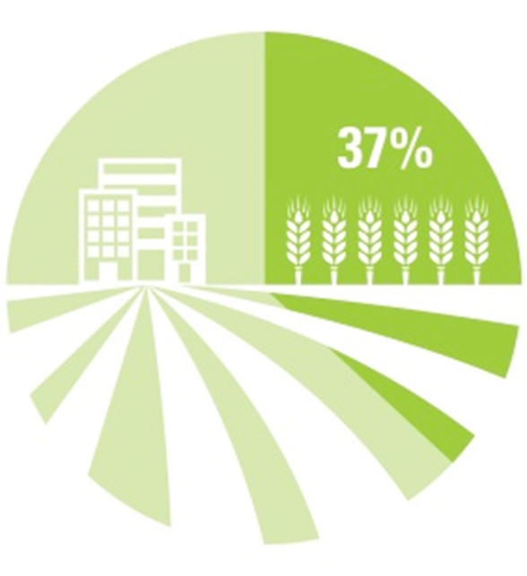
IMPACT ON RESOURCES
Notes:
The impact on natural resources and on the planet will be profound. As those in this room are well aware, we already use 37% of the worlds land for crops and pasture. Opening up new land will only lead to massive release of stored carbon, threatening to contribute even more to greenhouse gas emissions. Livestock production, particularly of cattle and sheep will emit more methane without technology and practices to mitigate and reduce emissions. Water use for agriculture will rise from 70% today to 89% by 2050—in developing countries, irrigation already uses 85% of extracted water!!! And Food Waste and loss also have an environmental impact, contributing to landfills and methane emissions, when they could be used for food, feed, energy, or other productive uses.

Slide 4

FARMS & FOOD SECURITY THREATENED BY
CLIMATE CHANGE AND
WEATHER VARIABILITY
Notes:
Climate change and weather variability will fundamentally alter global food production patterns. Adaptation practices in low latitude and tropical regions will be critical to maintain food production. Climate shifts will reduce renewable surface water and groundwater in most dry subtropical regions, intensifying competition for water. And Extreme precipitation events over much of the mid-latitutde regions will become more intense and more frequent as the worlds surface temperature increases.

Slide 5
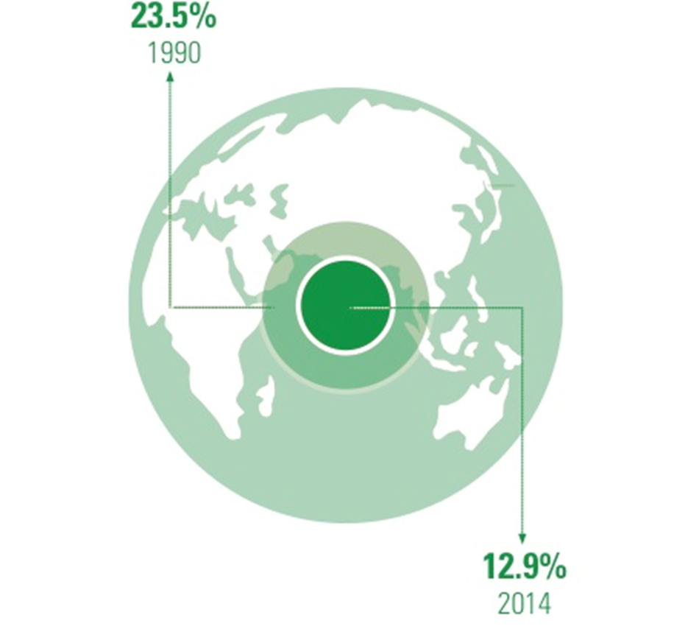
MEETING NUTRITIONAL NEEDS
Notes:
While the global proportion of undernourished people has decreased, from 24% in the 1990s to 13% today, we still face major challenges, particularly on the nutrition front. Both hunger and obesity impact our health. Today 1/3 of children suffer from hunger or some form of nutrient deficiency. Obesity is increasing rapidly in developing countries, and the proportion of the world’s overweight is now 39%, nearly doubling since 1980.

Slide 6
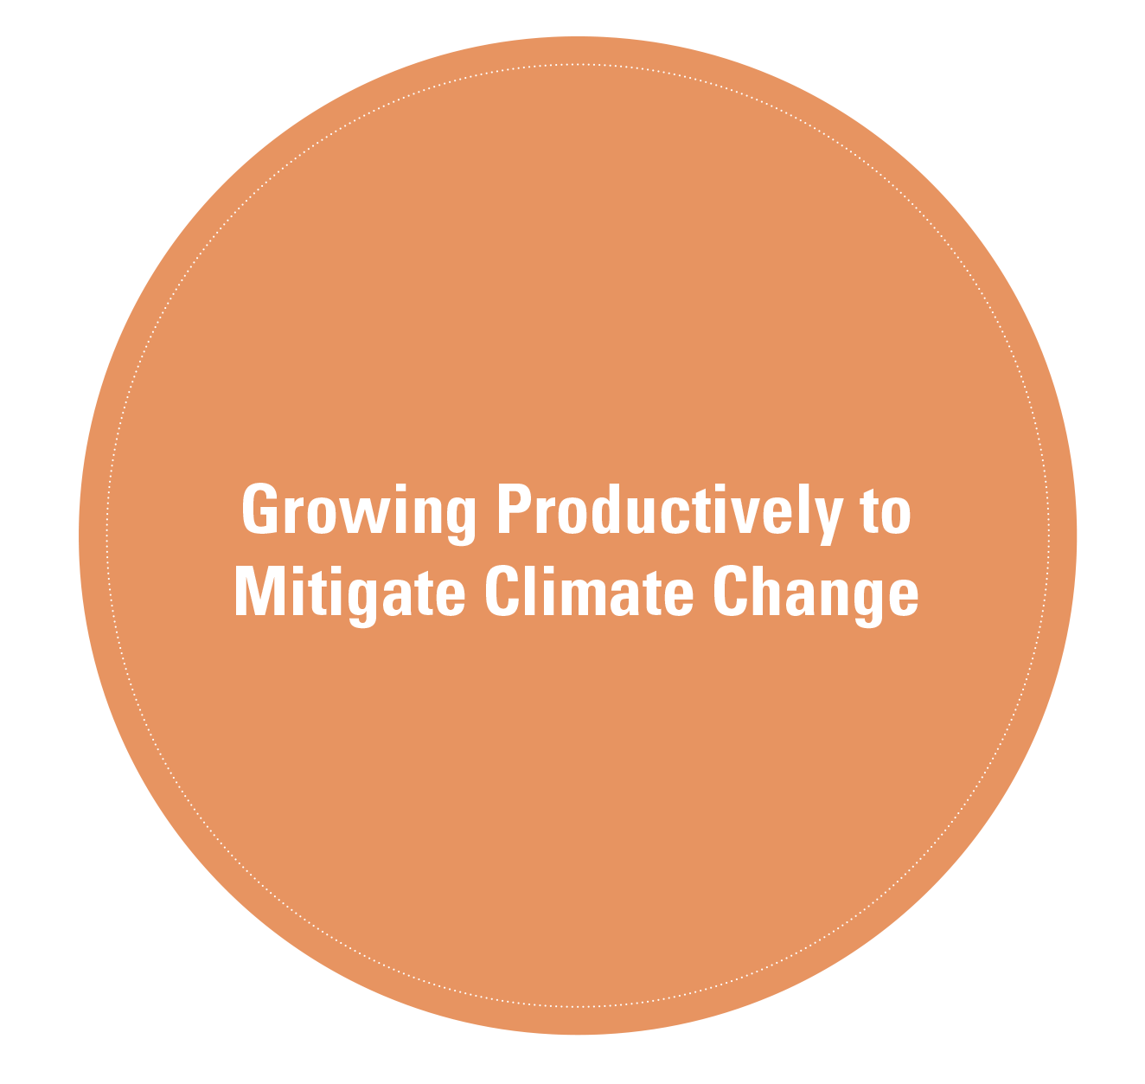
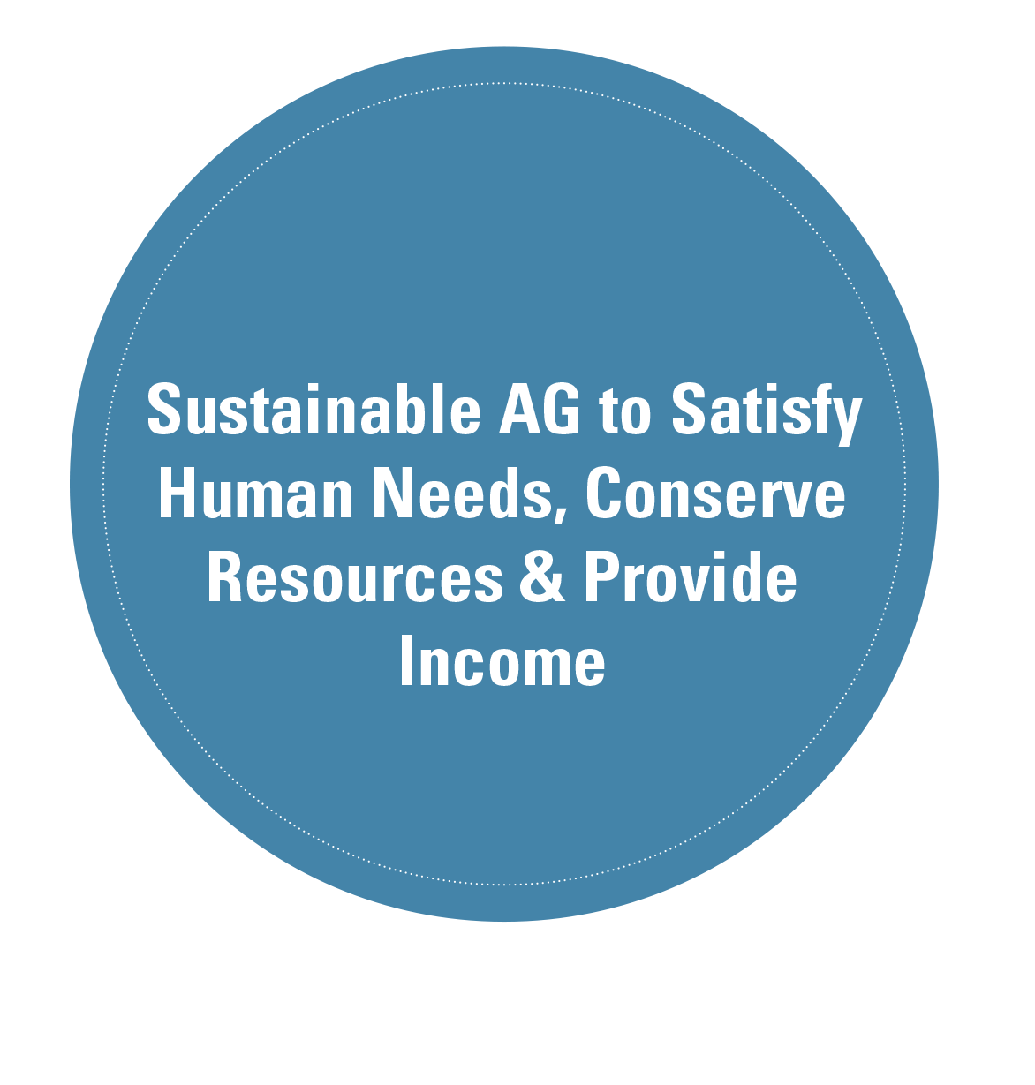
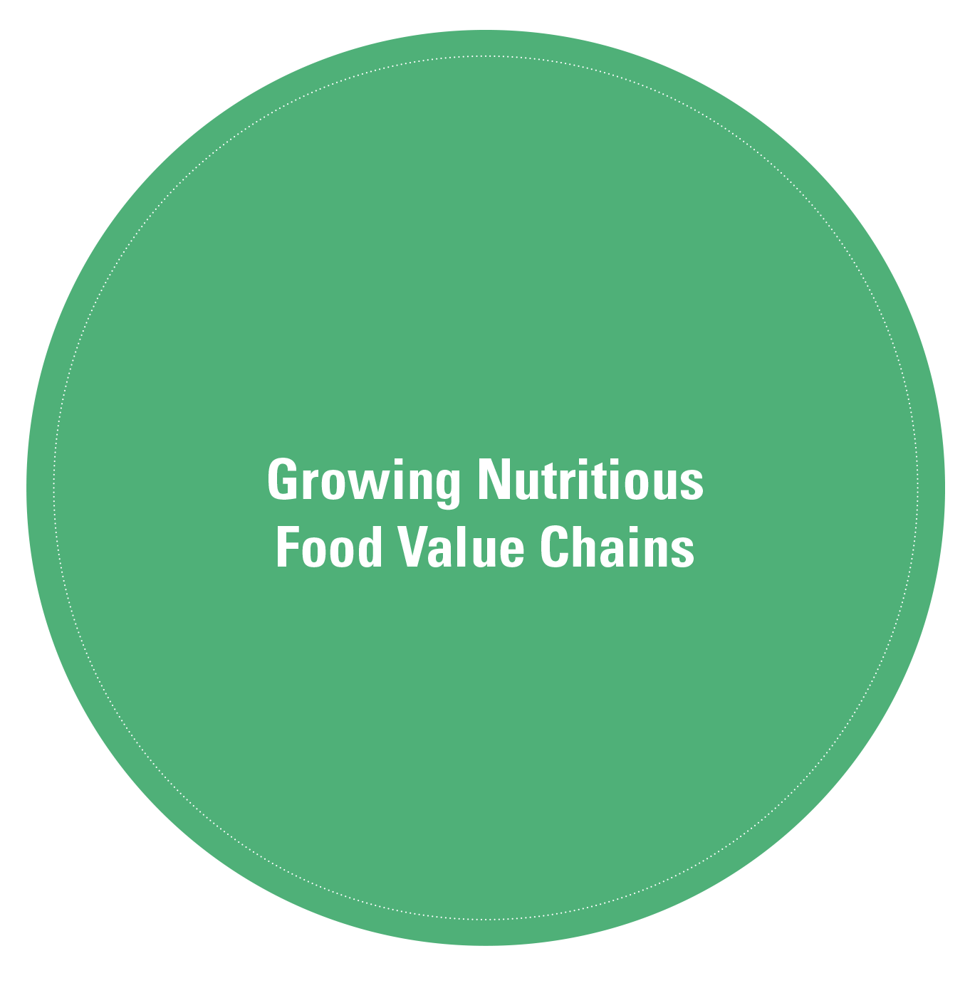
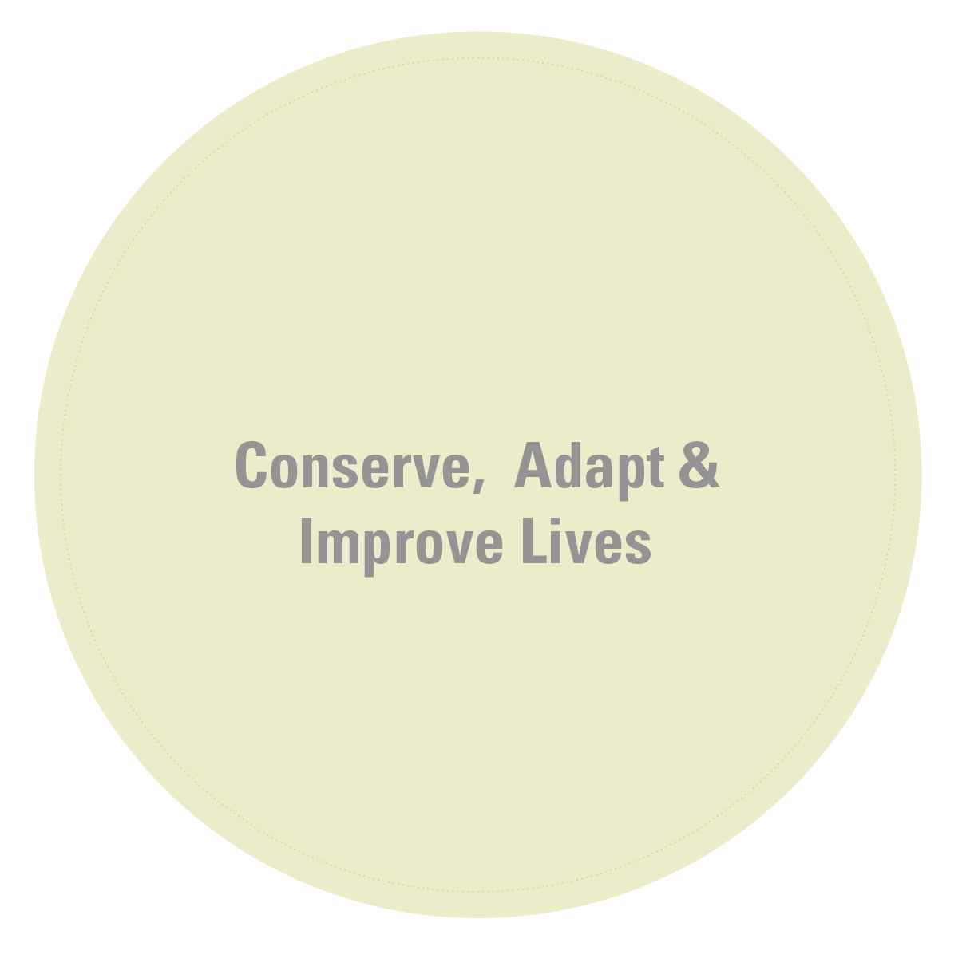
GROWING SOLUTIONS
Notes:
Together we can Grow Solutions to these challenges. The GAP Report outlines how farmers, governments, companies and civil society are collaborating to meet the needs. Only agriculture that is truly sustainable can supply human needs as well as provide income for farmers and growers; new innovation is helping to grow more productively so that agriculture and forestry can actually mitigate climate change; we are making progress in growing more nutritious food value chains; and we can Conserve land and water, Adapt to dietary changes and Improve the lives and livelihoods of farmers and rural communities as well as consumers. This should be our shared vision for agriculture: we should accept nothing less.

Slide 7
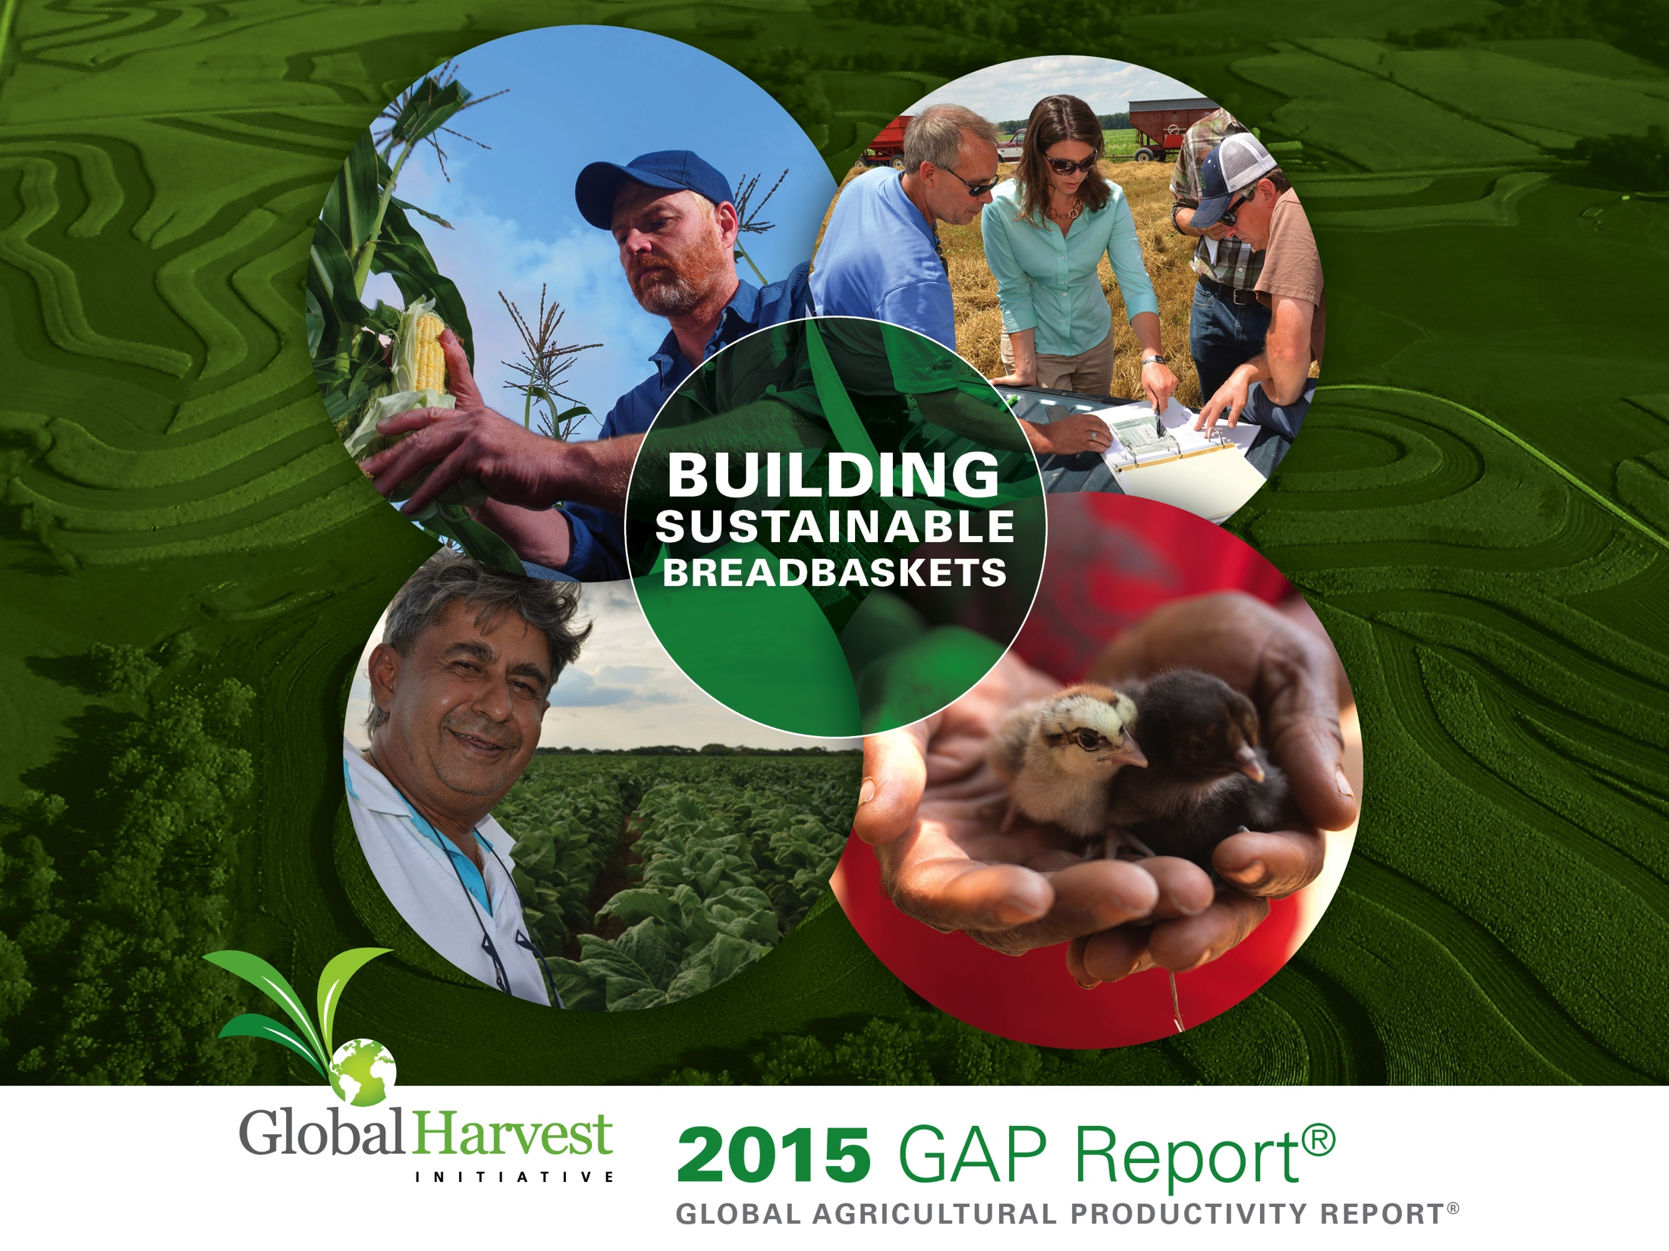
Notes:
This is our 6th GAP Report, in which we measure and track the global, regional and country level trends in productivity in agriculture, and highlight new innovations, technologies and partnerships to fight hunger, conserve the environment, and to strengthen value chains.

Slide 8

GHI MEMBERS AND PARTNERS
Notes:
The Global Harvest Initiative was formed in 2009 by companies that advocate for collaborative solutions to meet the rapidly rising demand for food and agricultural products.
GHI serves as a private sector policy voice for productivity growth throughout the agricultural value chain. We advance the conversation about how to produce more, waste less, and maximize the use of scarce resources.
GHI’s member companies are joined by 13 consultative partners – their logos are here on the screen – who share their knowledge of agriculture, conservation, nutrition, trade and the needs of small-scale farmers.

Slide 9
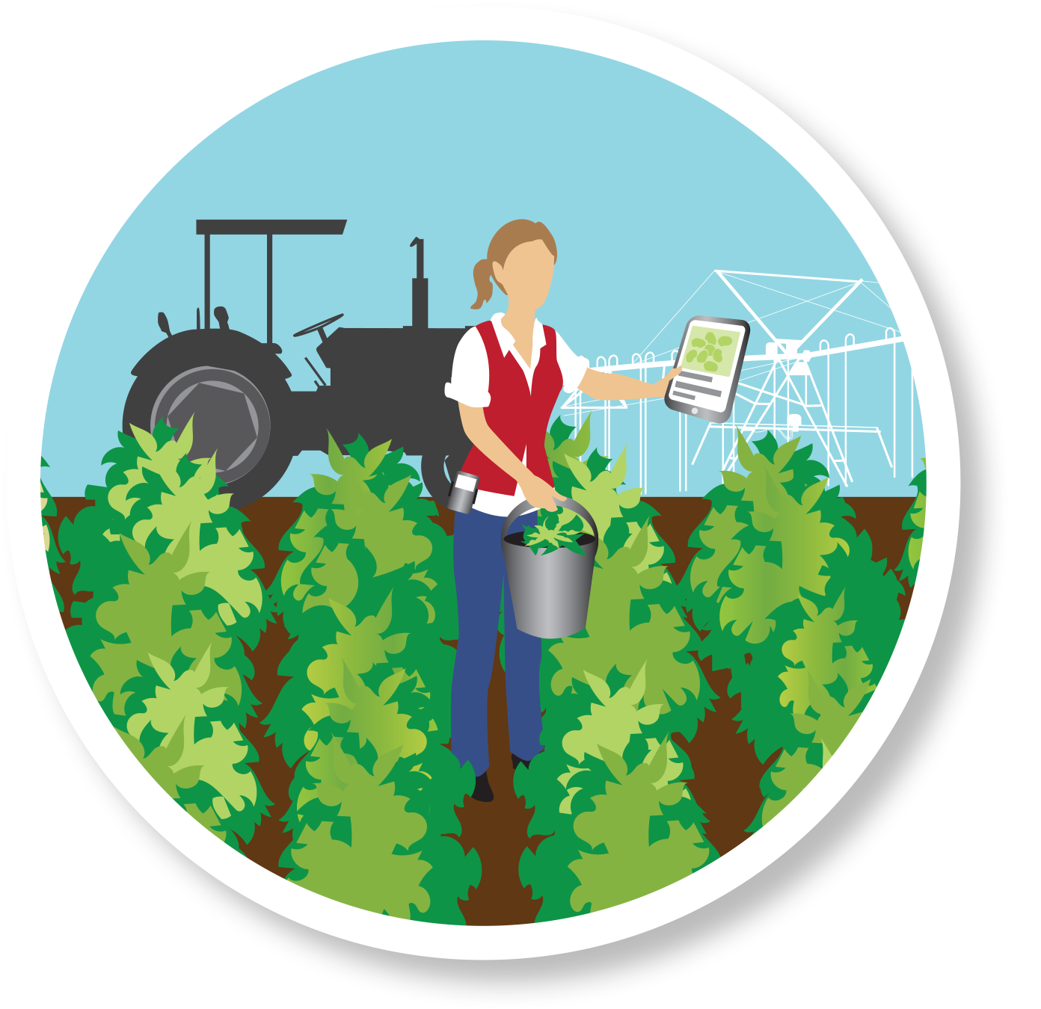
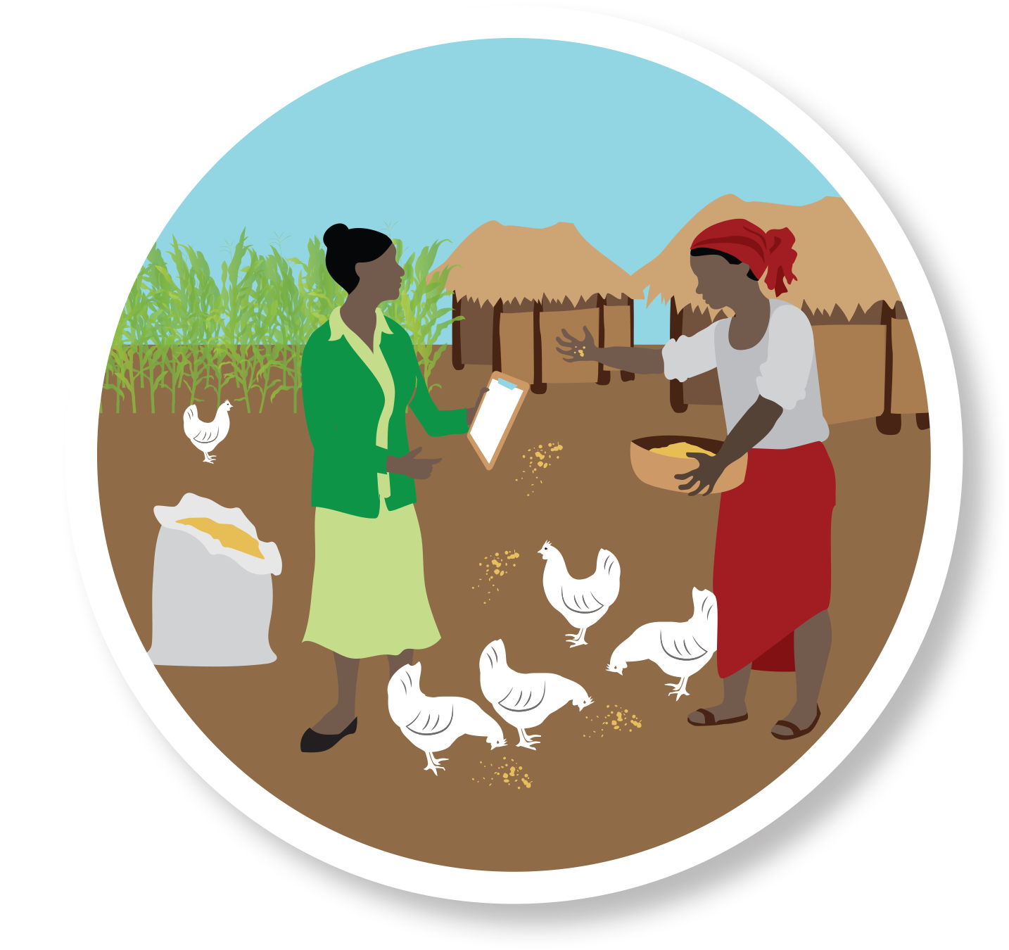
BUILDING SUSTAINABLE BREADBASKETS
U.S.A.
ZAMBIA
Notes:
The United Nations member states declared that eradicating hunger and poverty is both the greatest global challenge and an indispensable requirement for sustainable development.
A vibrant agriculture and food sector is a powerful foundation for broad-based, inclusive economic growth, creating multiplier effects throughout the entire economy. In light of the 2015 International Year of Soils, The GAP Report highlights the powerful legacy of the United States’ conservation agriculture system which was built in the wake of the 1930s Dust Bowl and has laid the foundation for a vibrant and productive agricultural economy. And the report shines a spotlight on Zambia, a country that is rising to diversify its agricultural potential and build its capacity to become a regional breadbasket in Southern Africa.

Slide 10
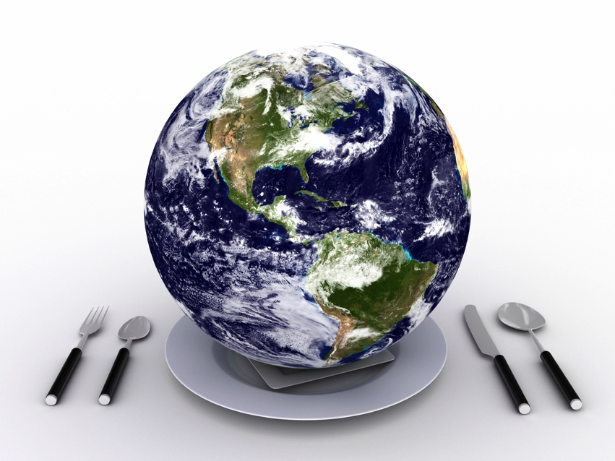
COMPREHENSIVE STRATEGY
TO FEED THE WORLD
Accelerate agricultural productivity
Reduce food waste & loss
Improve incomes, sanitation & nutrition
Target support to small-scale farmers
Notes:
Improving Productivity is one step in a comprehensive strategy to feed the world. Governments, civil society, farmers and private industry must also work together to reduce food loss and waste, improve incomes, sanitation and nutrition, and target support to small-scale farmers, who often are those most in need of attention and help.

Slide 11
STRATEGIES FOR PRODUCING MORE
Expanding Land
Intensifying Inputs
Extending Irrigation
Increasing Efficiency with Total Factor Productivity
Notes:
The GAP Report explores practices that producers use for providing more food, feed, fiber and biofuels. Producers can increase their output by
Expanding into new land areas,
Intensifying the usage of inputs by using more fertilizer, machinery, and crop protection products.
Extending irrigation to cropland that previously was rain fed.
Or, producers are adopting technologies and practices that result in more output from existing or even fewer resources, measured by Total Factor Productivity, or TFP.

Slide 12
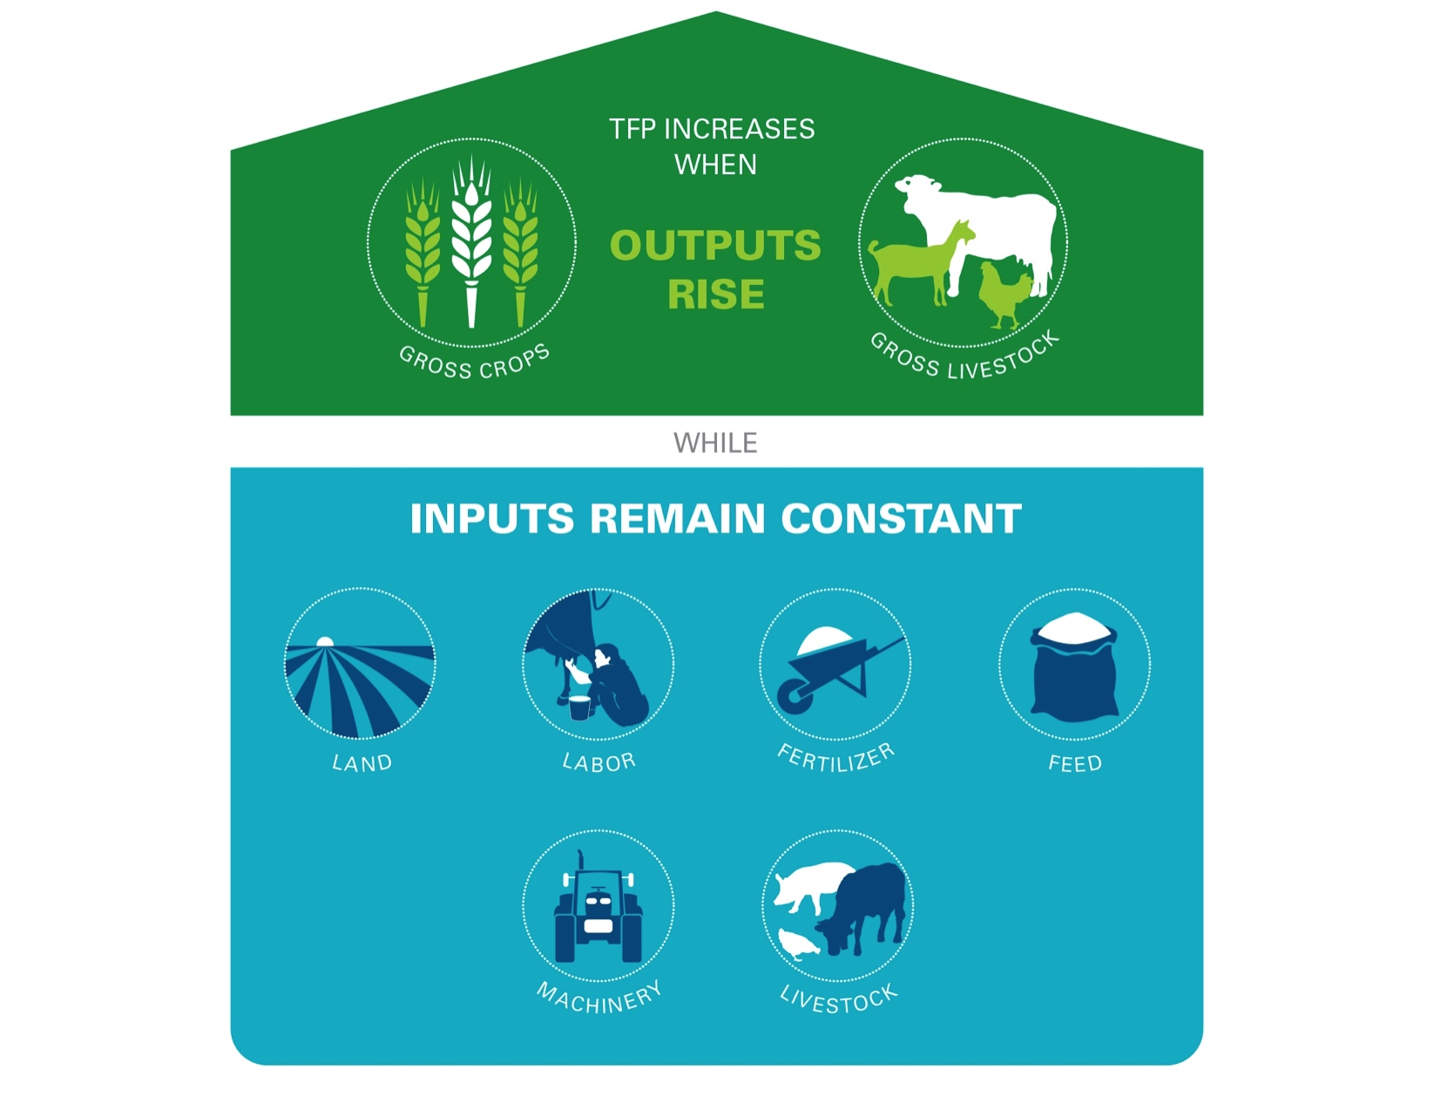
TOTAL FACTOR PRODUCTIVITY (TFP)
Notes:
TFP is the ratio of agricultural outputs, such as crops and livestock, to the resources we use to produce them: land, labor, fertilizer, feed, machinery and livestock. Productivity will grow as farmers use these inputs more precisely and effectively. Farmers increase TFP through more timely practices of nutrient application, cultivation, and harvest, or by using higher yield seeds that are disease, pest and drought tolerant. Livestock producers increase TFP by raising animals with favorable genetic qualities and using better animal care practices.
Understanding TFP trends at the country, regional and global levels is important, because farmers and policymakers are not just interested in seeing if agricultural output is growing—they want to know if it is due to better use of scarce inputs. Measuring TFP is the best way to get this information.

Slide 13
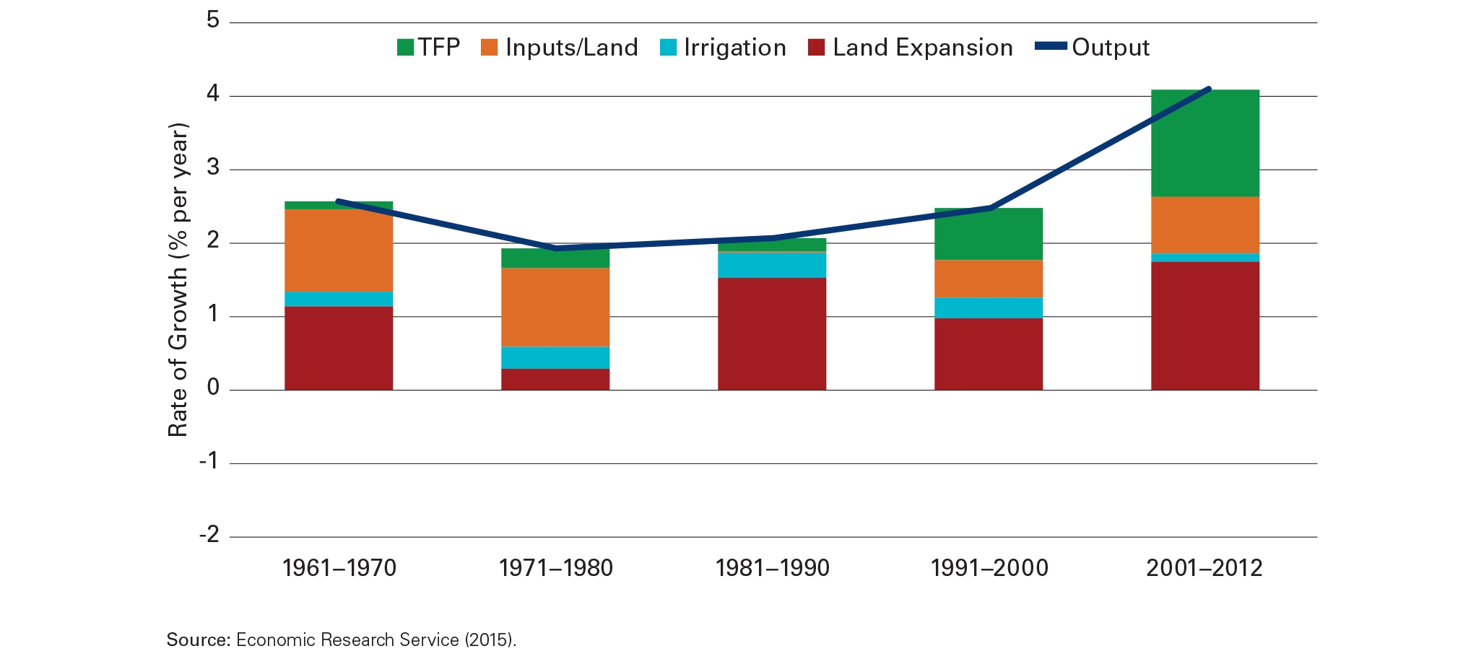
LOW-INCOME COUNTRIES
Notes:
Using data from the USDA Economic Research Service, the GAP Report shows that over time, low income countries are beginning to increase their agricultural output. In recent decades, especially the last decade, productivity is also rising, as the green bars shows. However, we see a significant expansion of land, the red bar, as well, indicating that land is being converted to production. This has environmental impact, as forestry and habitat loss increase and carbon stored in soil is released. Low income countries must place TFP at the heart of their agricultural policy agenda in order to produce more sustainably.

Slide 14
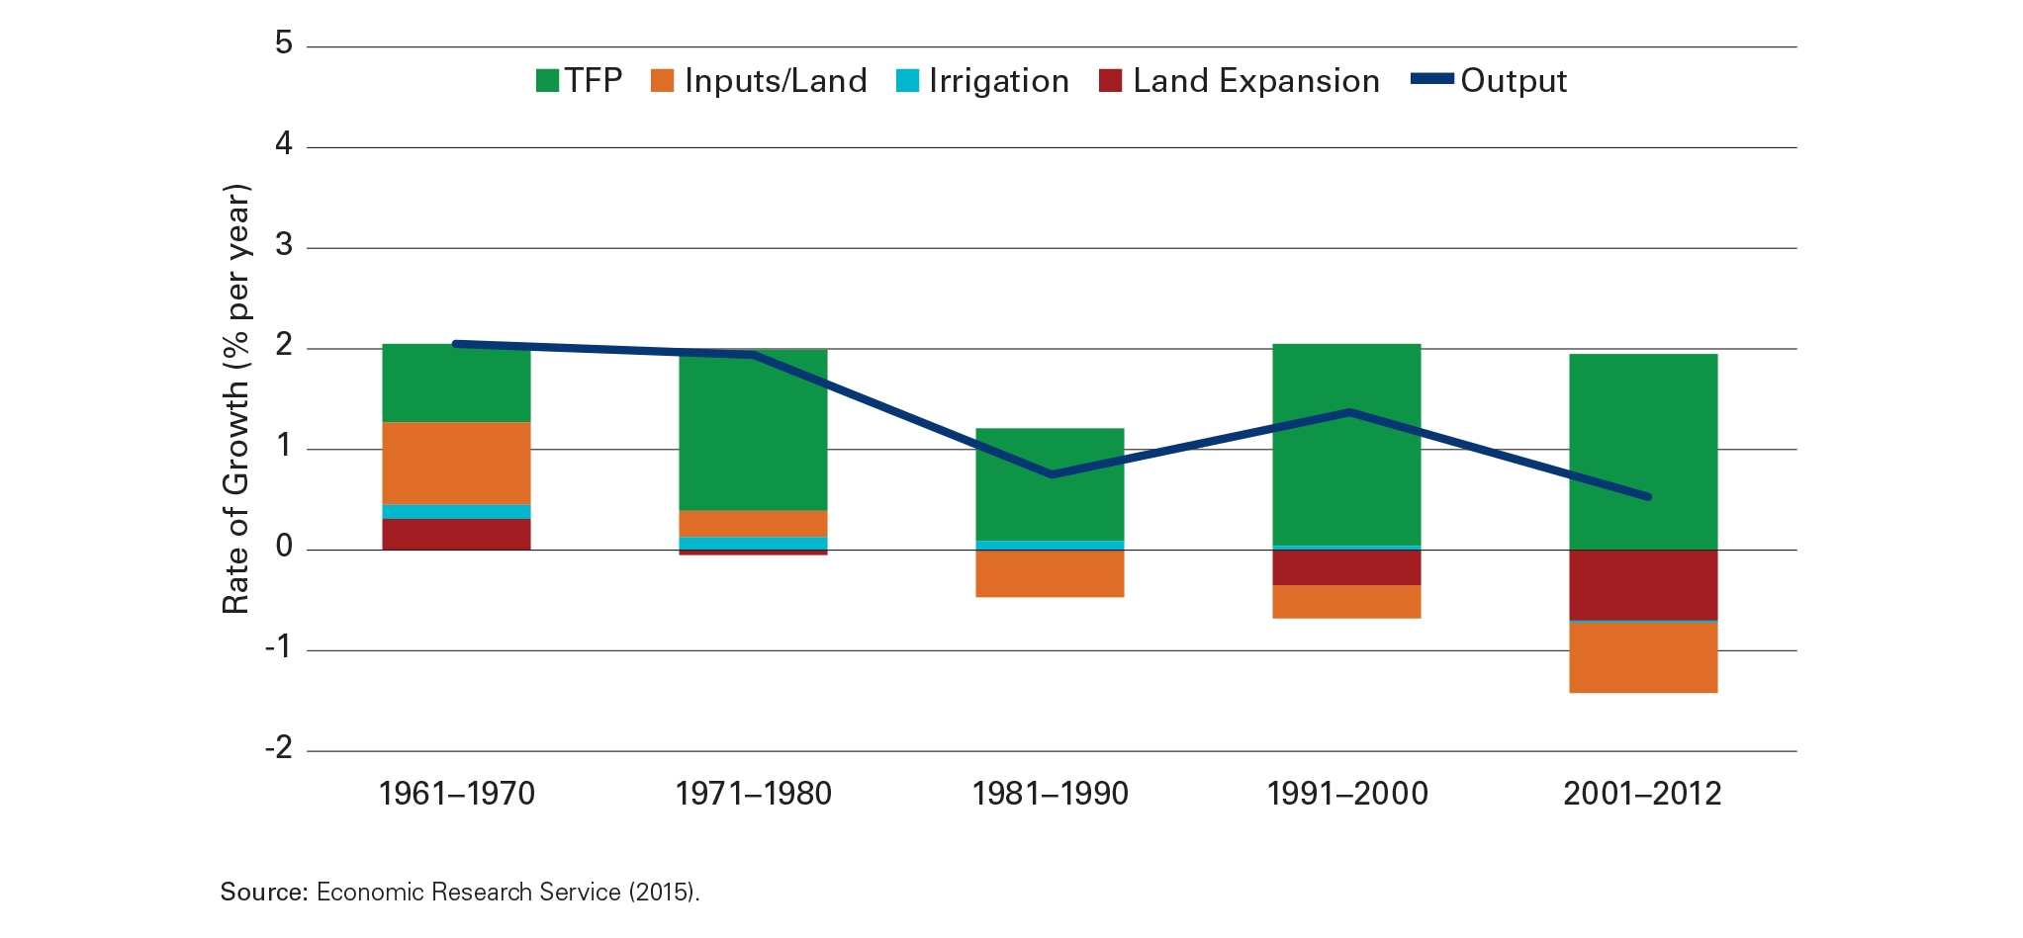
HIGH-INCOME COUNTRIES
Notes:
For high income countries, we see how decades of public and private investment in agricultural research and extension services, along with rural infrastructure and adoption of technology, have made TFP the principle source of growth in agricultural output. This high productivity has allowed some land to be placed in conservation. With new advances on the horizon, such as more widely available precision agriculture and data management, we should see additional TFP growth.

Slide 15
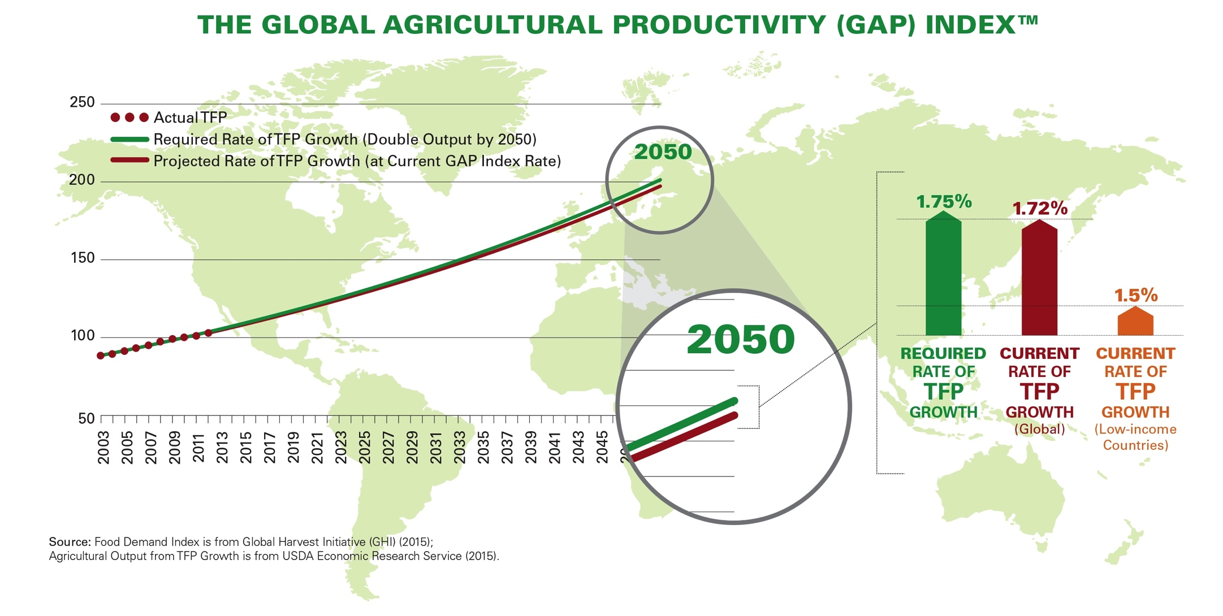
HOW WILL WE FEED THE FUTURE?
Notes:
The Global Agricultural Productivity, or GAP, Index has been designed by GHI to measure how we are doing in our efforts to improve productivity to meet the food, feed, fiber and biofuel needs of 9.7B people by 2050. Five years ago, GHI calculated that global TFP must grow, on average, by 1.75% per year to meet the coming demand. This year’s analysis indicates that, for the second year in a row, productivity is not keeping pace—it’s only at 1.72%. Even more concerning is the 1.5% growth rate of low income countries—far lower than required. Unless these countries improve their TFP, they will have to address food shortages by importing or expanding production into marginal land, so some don’t go hungry.

Slide 16
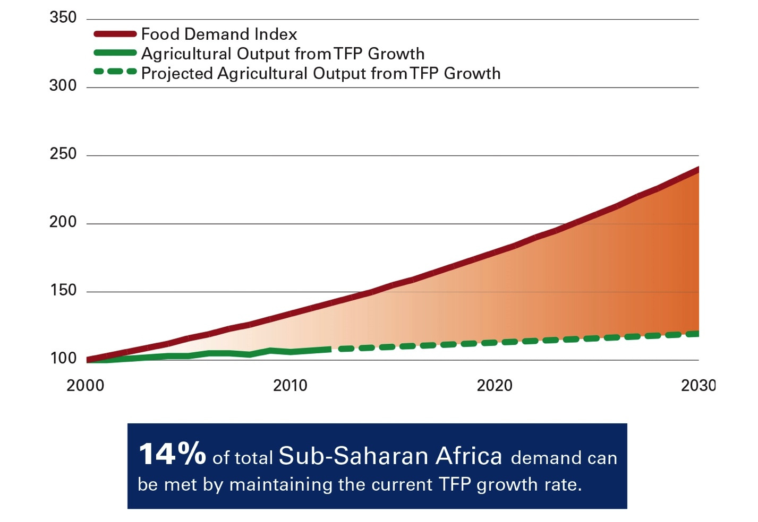
AFRICA’S FOOD GAP
Notes:
Our analysis also looked at various regional food demand gaps that will be faced in 2030. For example, at current rates of productivity growth, sub-Saharan African countries will only meet 14% of their own needs.

Slide 17
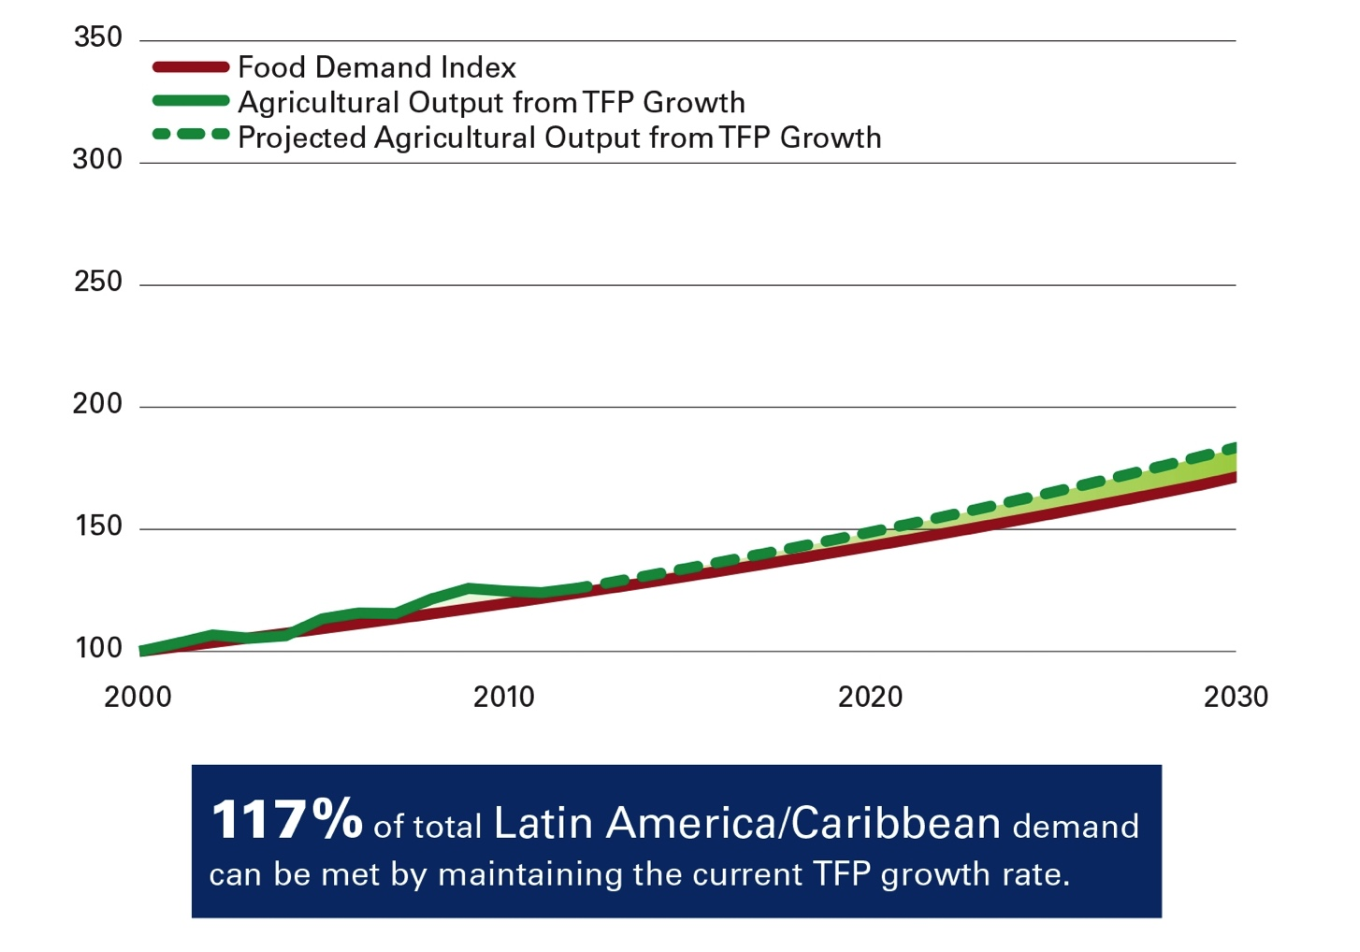
CLOSING THE GAP
LATIN AMERICA’S POTENTIAL
Notes:
On the other hand, Latin America has great potential, as seen in this chart. It shows an increasing ability to produce more with the same or fewer resources, exceeding its food needs. The GAP report has details like this of other regions, as well.

Slide 18
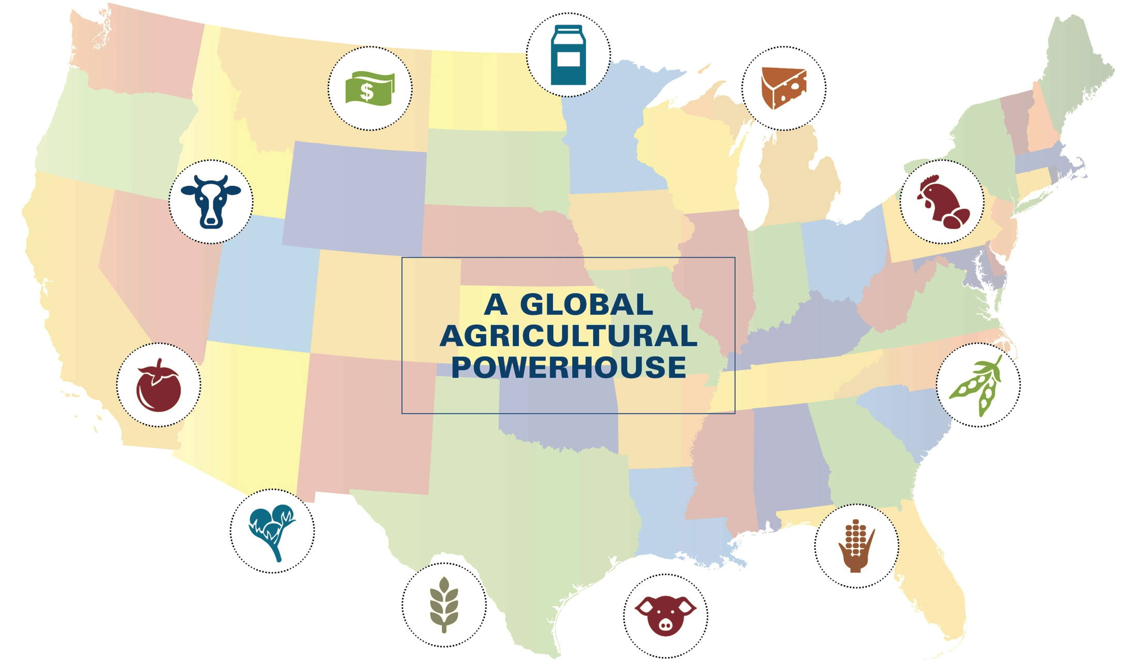
Notes:
Next, the GAP report examines the dynamic agriculture and food systems of our own United States of America. Using a wide array of production methods, American farmers meet demand for more for 321M consumers with a wide range of preferences. Agriculture is a key driver of US economic growth, providing $2T in revenue for more than 2.6M businesses.

Slide 19
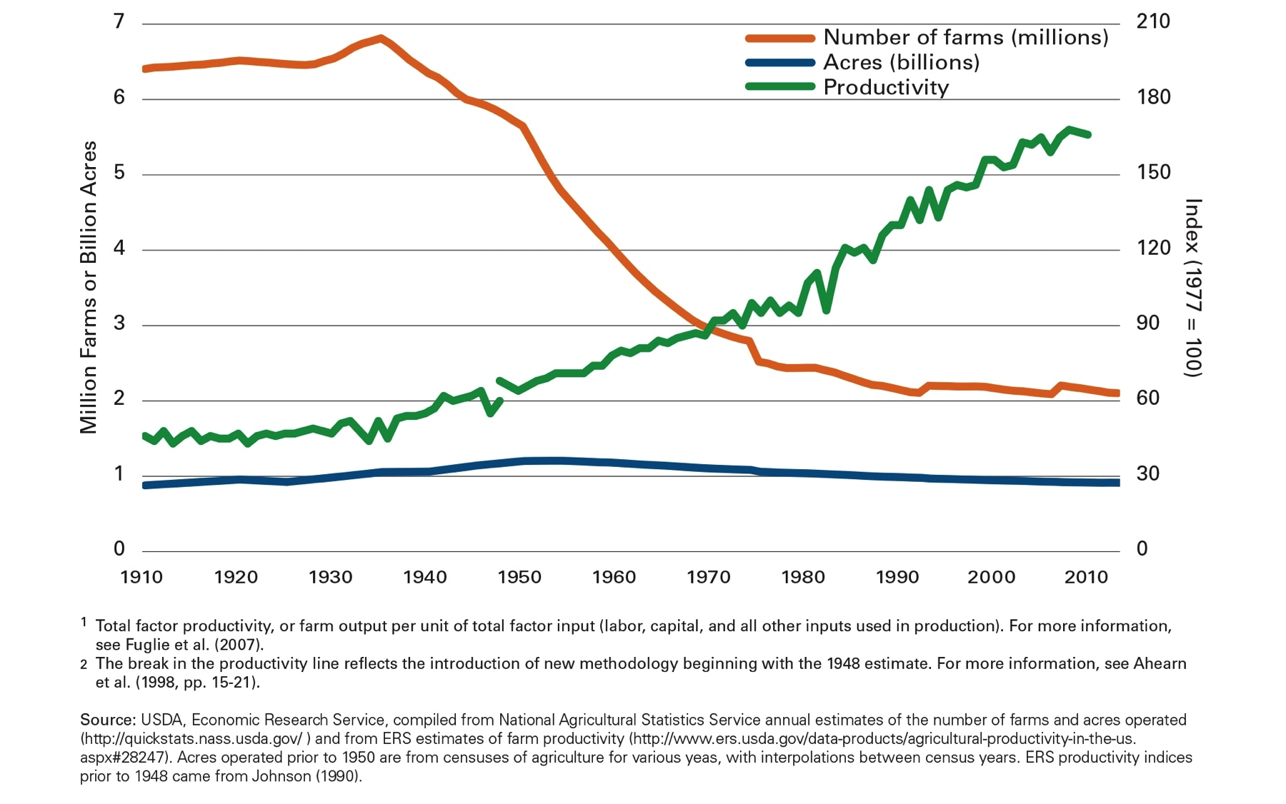
U.S. PRODUCTIVITY GROWTH
Notes:
Over the past 100 years, the US Agriculture system has evolved dramatically. Productivity since 1948 has grown 156%, with total inputs, including land acrage, largely unchanged. Today this enormously productive output is delivered by less than 2% of the US population who work directly in agriculture, freeing 98% of us to pursue other livelihoods.

Slide 20
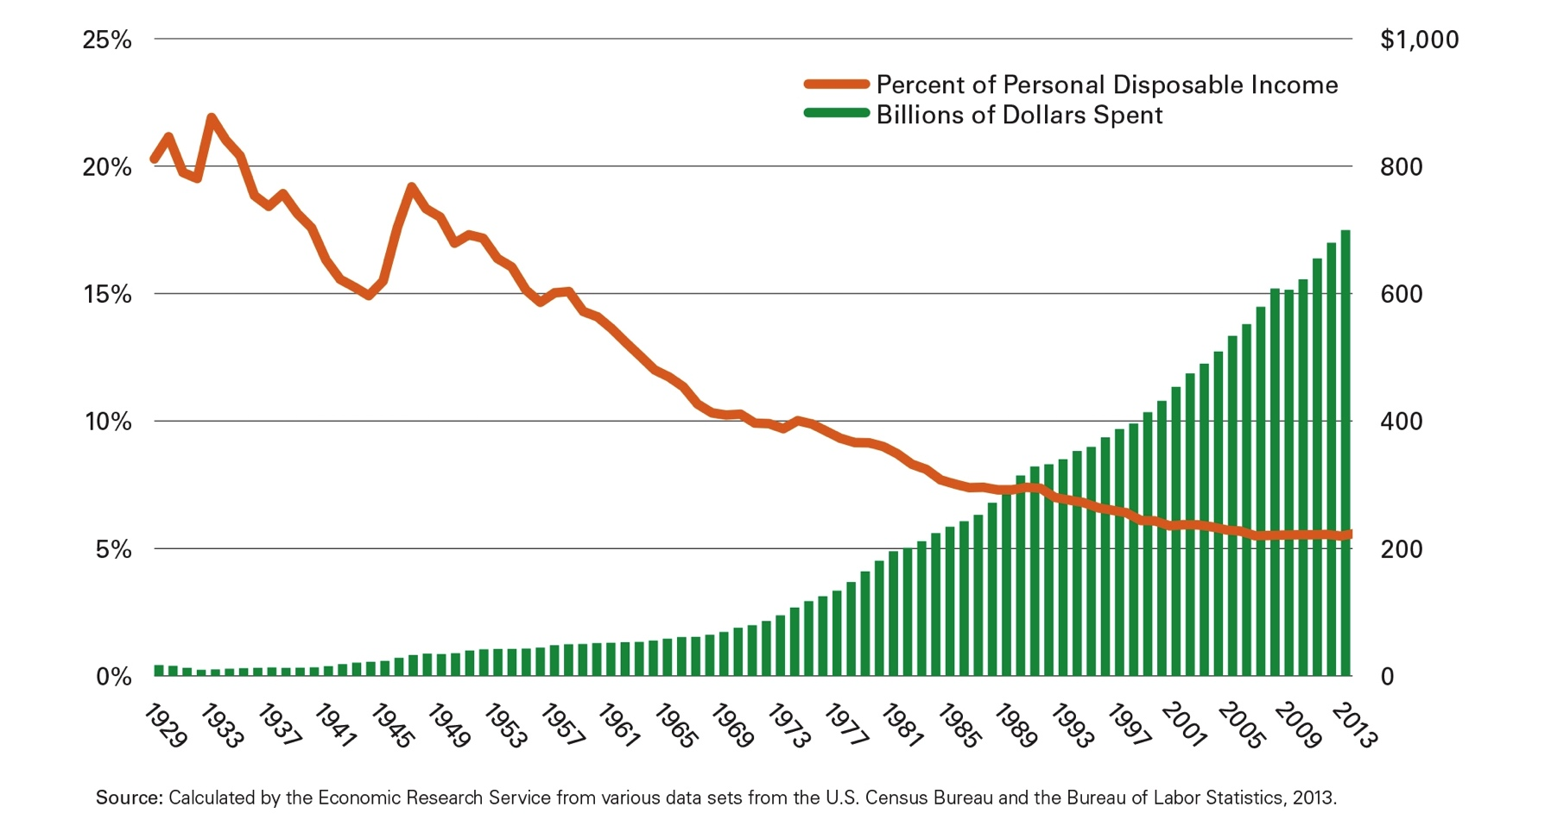
BENEFITS FOR THE U.S. CONSUMER
Americans spend just
6%
of their disposable income on food
Notes:
US consumers have benefitted from this powerful agricultural system. The percent of disposable income spent on food has declined dramatically, from 22% in the 1930s to 6% today. Actually, the average US consumer spends the lowest percentage of household income on food out of 86 major countries.

Slide 21
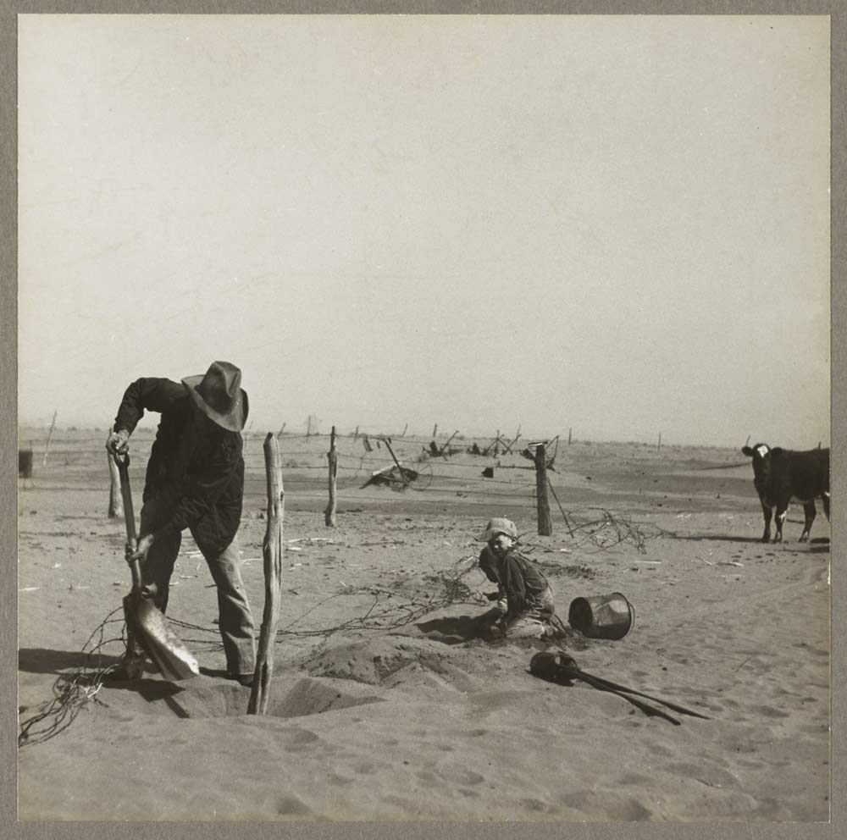
LEGACY OF THE U.S.
CONSERVATION SYSTEM
Notes:
Agricultural productivity in the US has grown hand in hand with the creation of a dynamic conservation system that protects resources, habitats and wildlife. The GAP Report details how it reaches into virtually every rural community with technical and financial assistance targeted to local needs.

Slide 22
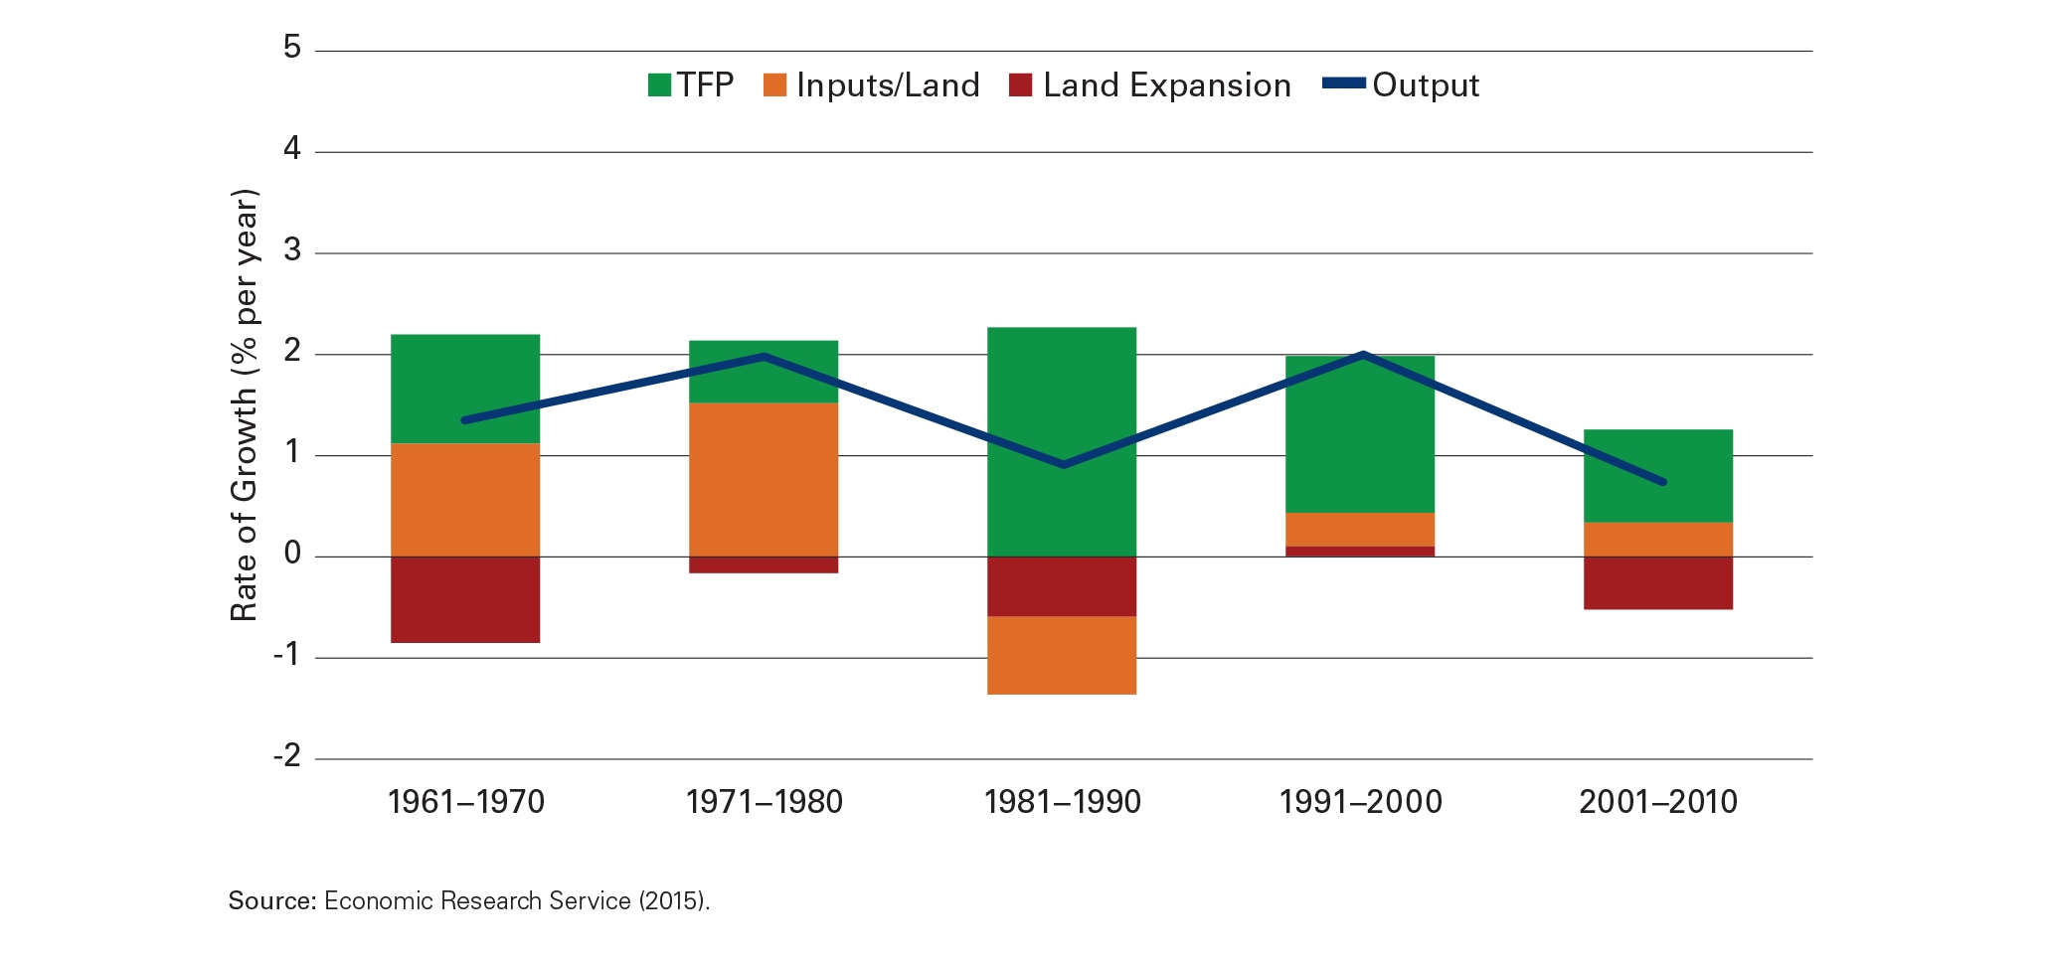
NEW CHALLENGES EMERGE
U.S. TFP
Notes:
Over the past decade, US agricultural output has begun to slow from a historical annual growth rate of 1.5-2.0% to only 1% today. The GAP Report discusses this slow down and the new challenges we face, such as:
How public funds for Ag research and development are not keeping pace with levels needed to keep productivity up;
And how the number of farm operators over age 55 is now at 68%, with those under 35 at only 5%: we have an American “farmer gap” in our future.

Slide 23
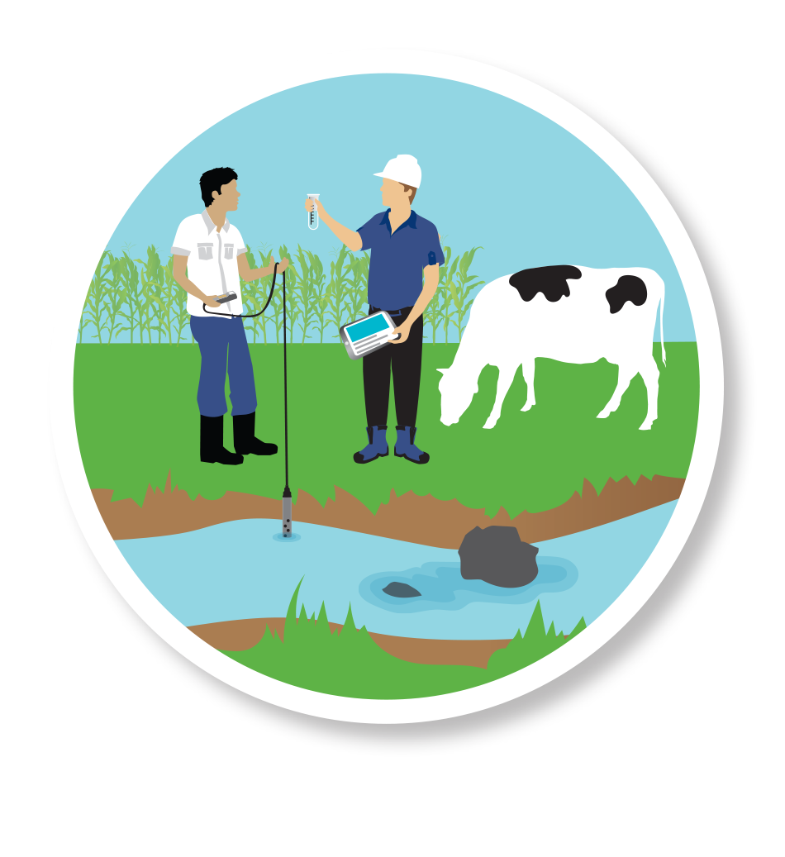
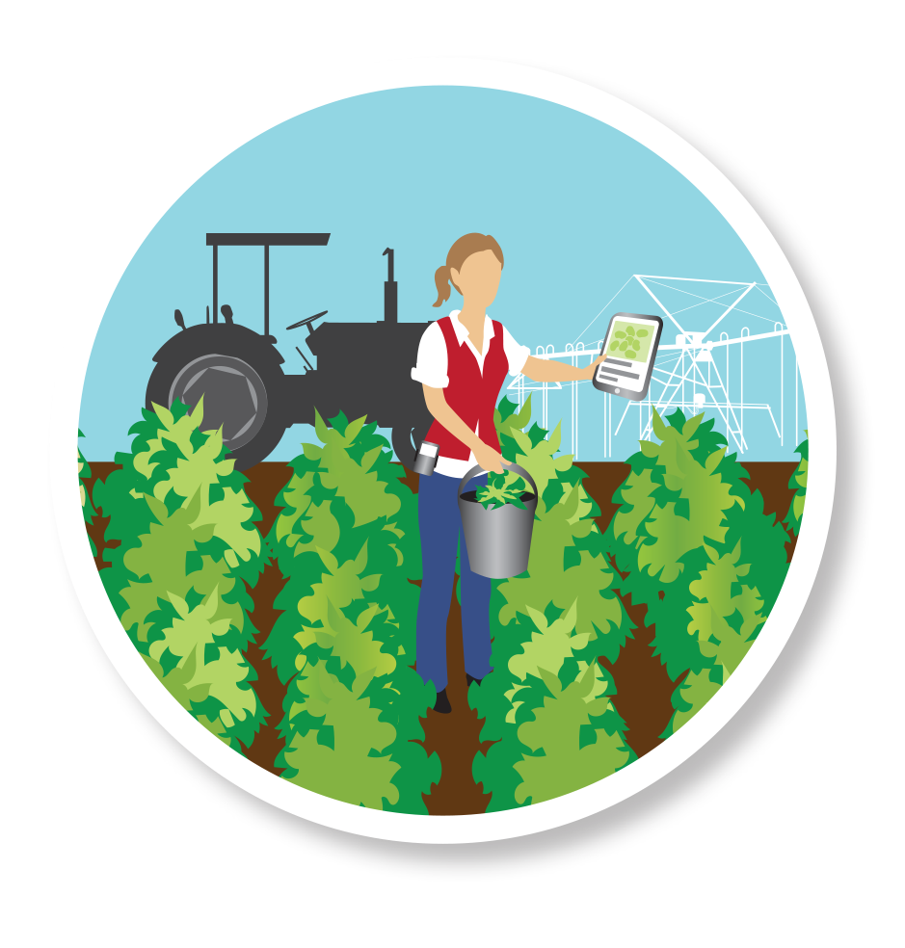

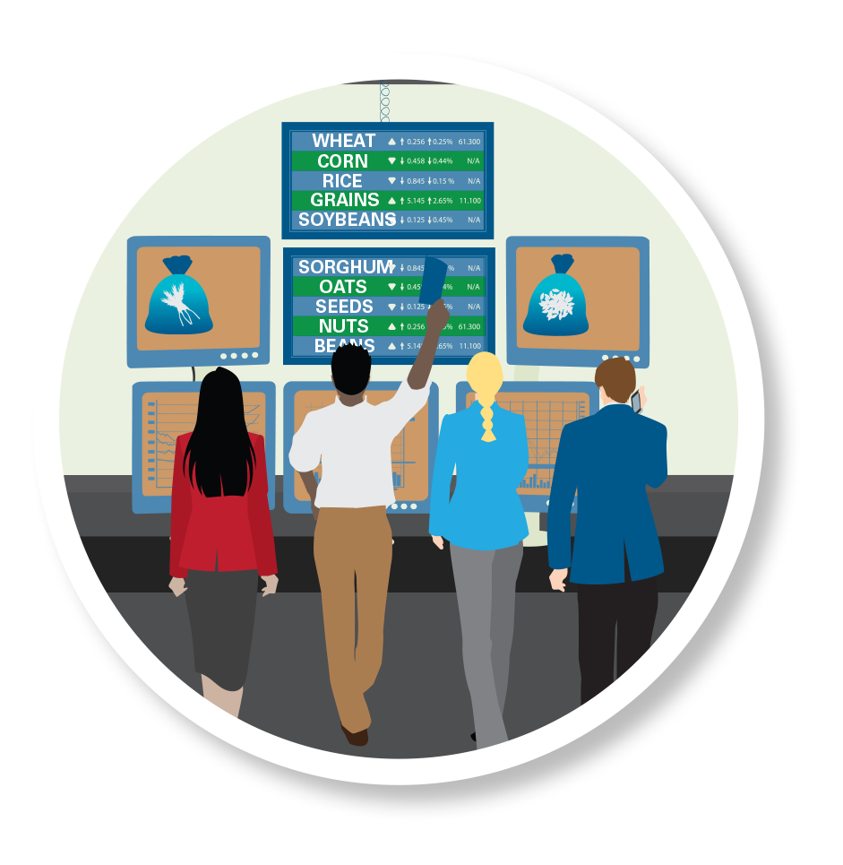



U.S. AG & FOOD VALUE CHAIN
Notes:
Together we must forge solutions to these challenges at every point along the food and agriculture value chain. For instance, farmers will need high quality inputs. Governments will need to provide helpful regulations. And consumers, who have a “trust gap” when it comes to food production, will need more transparency in ag processes. The GAP Report calls for farmers, agribusiness, consumers and the government to forge new ways to bridge this gap.

Slide 24
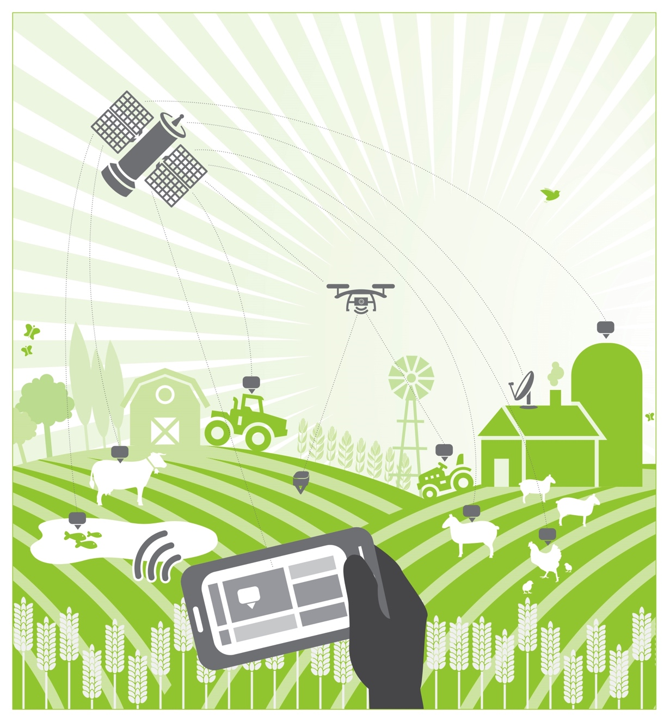
FARM SMART – CONSERVE SMART
Notes:
New practices and technologies are helping us “Farm Smart and Conserve Smart.” With the right data, and actionable information, farmers can maximize production on land that produces well and target other land for conservation. Precision technologies also help livestock and aquaculture producers improve productivity and maximize the usage of scarce resources. And very importantly now, during a time of lower commodity prices for farmers and ranchers, the use of such precision systems and tools can help them cut costs, to manage through the challenging agricultural business cycle of today!

Slide 25
GROWING MORE – EMITTING LESS
Notes:
Agriculture and forestry production produces almost a quarter of global greenhouse gas emissions. By adopting innovative conservation technologies, precision systems and practices, the sector could reduce net emissions by half by 2050 while still meeting global needs. A full range of agricultural practices and technologies, including cropland technology and livestock management can reduce the carbon footprint of food. It is possible to grow more and emit less!

Slide 26
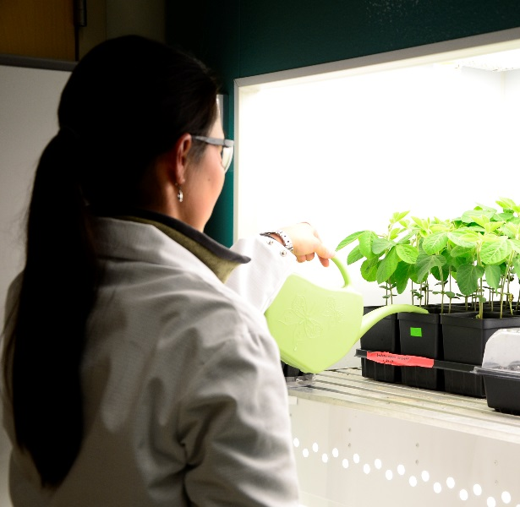
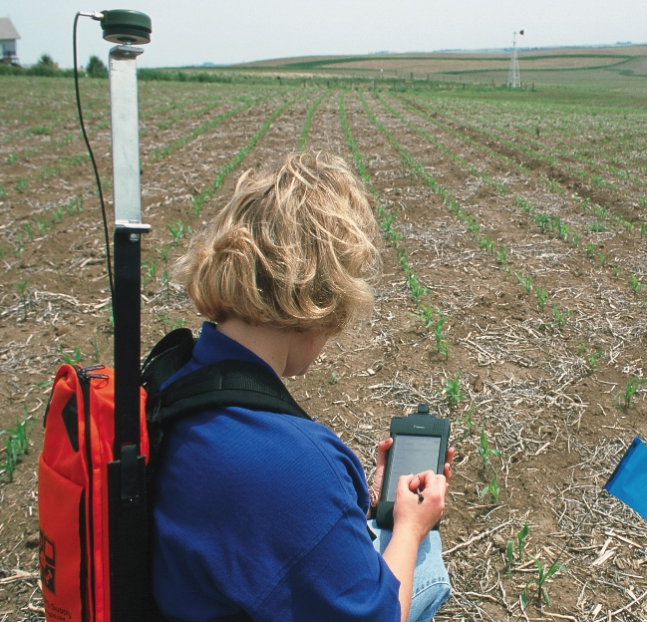
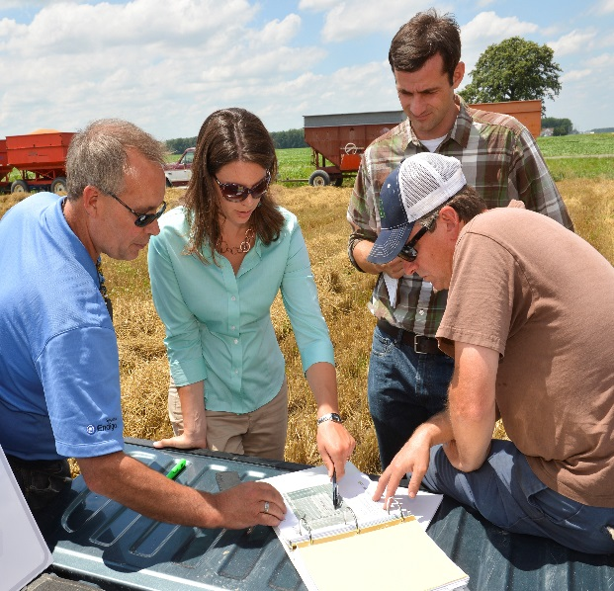
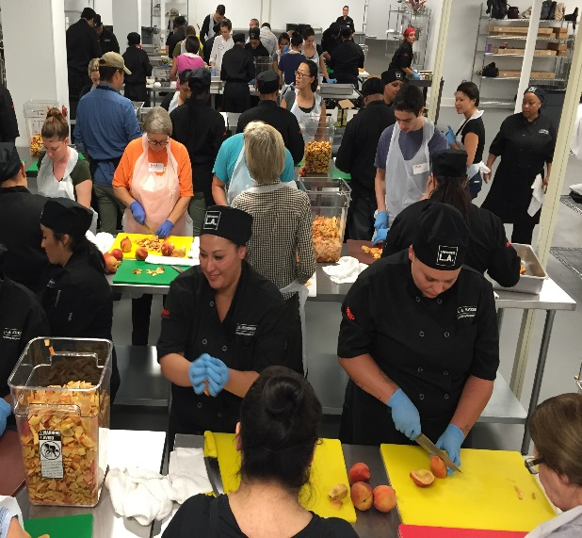
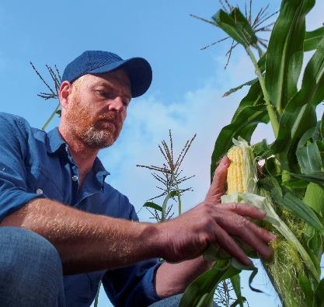
COLLABORATIONS TO
CONSERVE – ADAPT – IMPROVE
Notes:
US value chains can become more productive and sustainable. The GAP Report provides a series of case studies describing collaborations that help produce more sustainably, such as the State of Indiana who is leading new collaborative conservation movements and Nebraska who is serving as a global leader in groundwater management. Natural solutions like microbes and enzymes are being harnessed to reduce fertilizer loss and improve water, too.

Slide 27
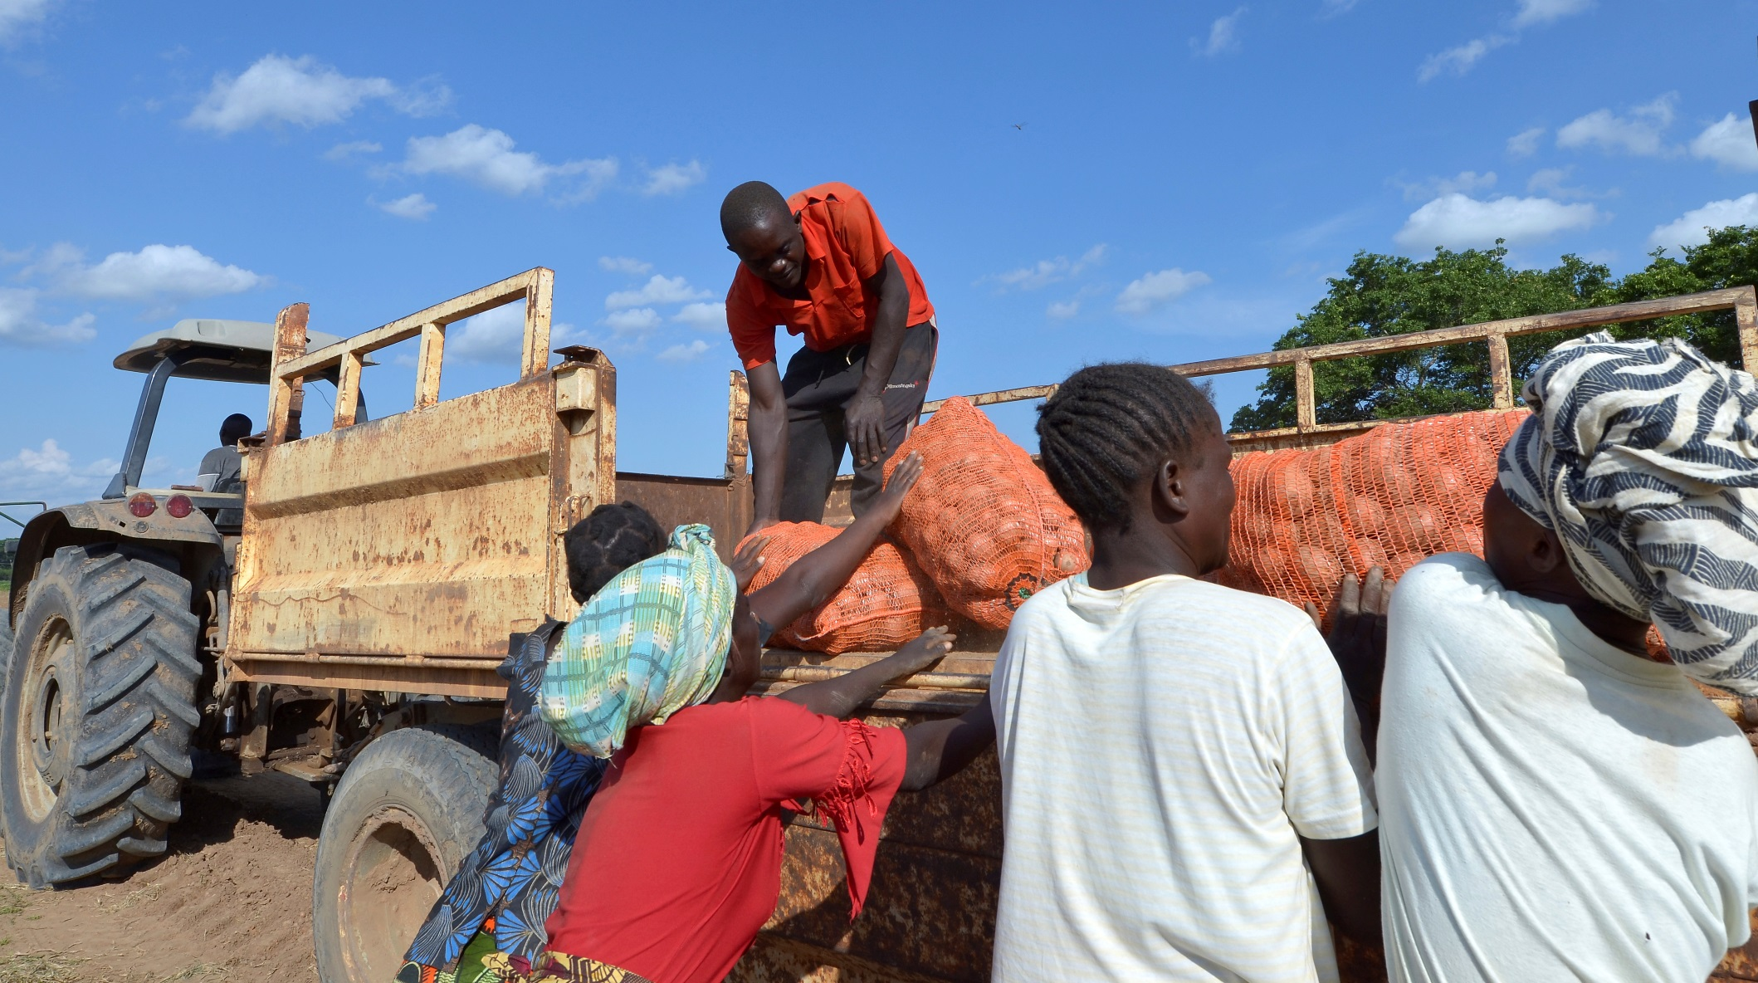
BUILDING A SUSTAINABLE BREADBASKET IN ZAMBIA
Notes:
In lower-income countries, great potential exists for advancing along the productivity frontier. For example, Zambia’s natural resource base, stable government, and investor friendly policies make it a potential breadbasket for southern Africa.
Zambian producers are a testimony to its agricultural promise. The country’s large-scale farms are some of the most productive in Africa and an emerging class of medium-scale farmers is contributing to the agricultural value chain.
Small-scale farmers are protecting their soils and increasing yields thanks to improved seeds, fertilizer, mechanization and conservation farming techniques.

Slide 28
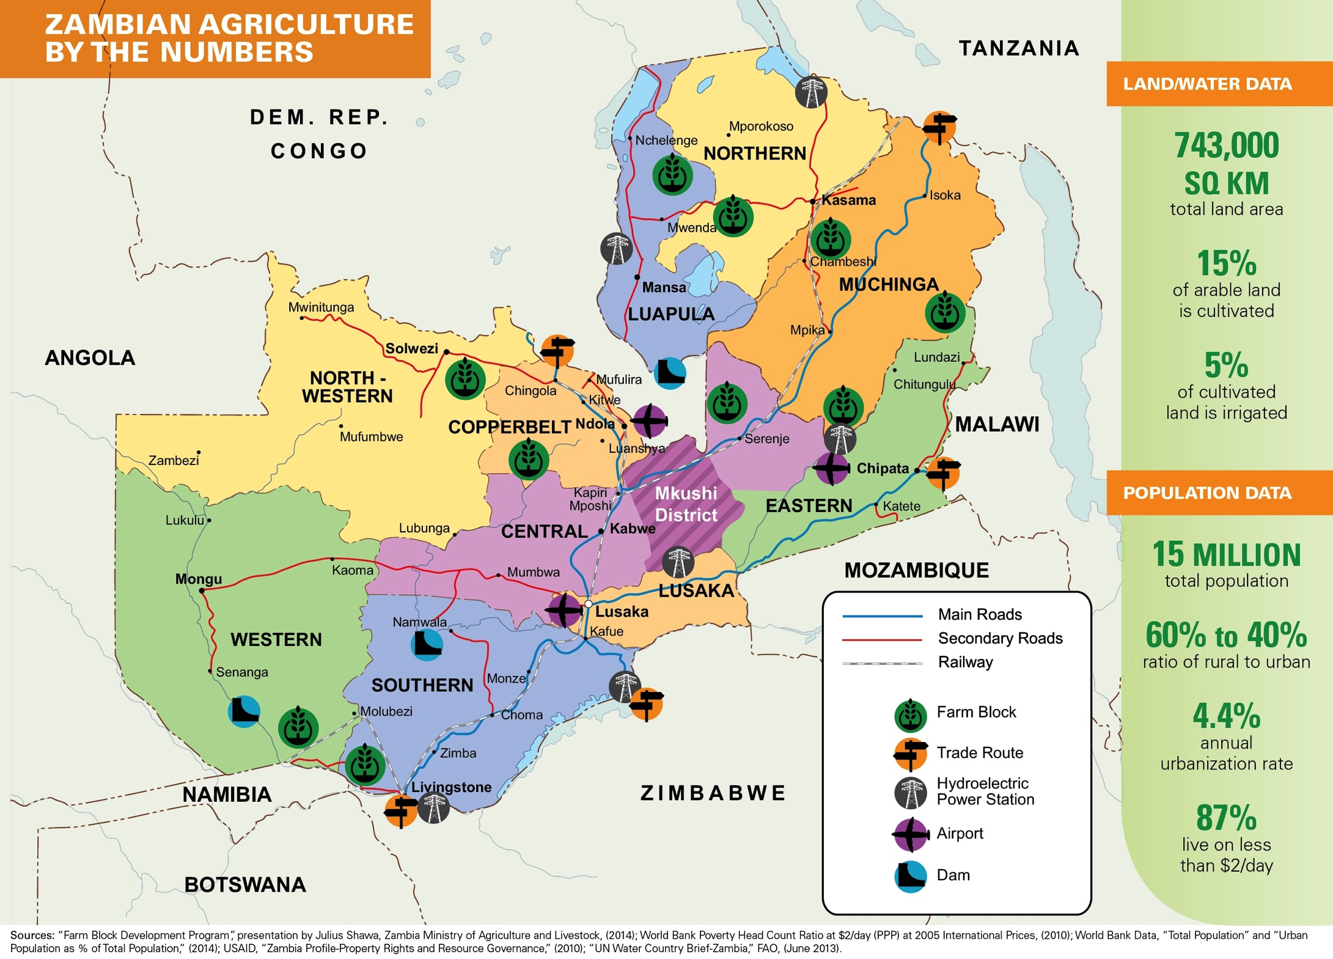
Notes:
Zambian governments have looked to agriculture to grow and diversify an economy that is heavily reliant on volatile mineral markets.
Nonetheless, the value added by agriculture to Zambia’s GDP remains in the 7 to 10 percent range and rural poverty rates are stubbornly entrenched around 80 percent.
In addition, decades of underdevelopment have left Zambia’s agricultural value chains vulnerable to environmental shocks and changing climate patterns.

Slide 29
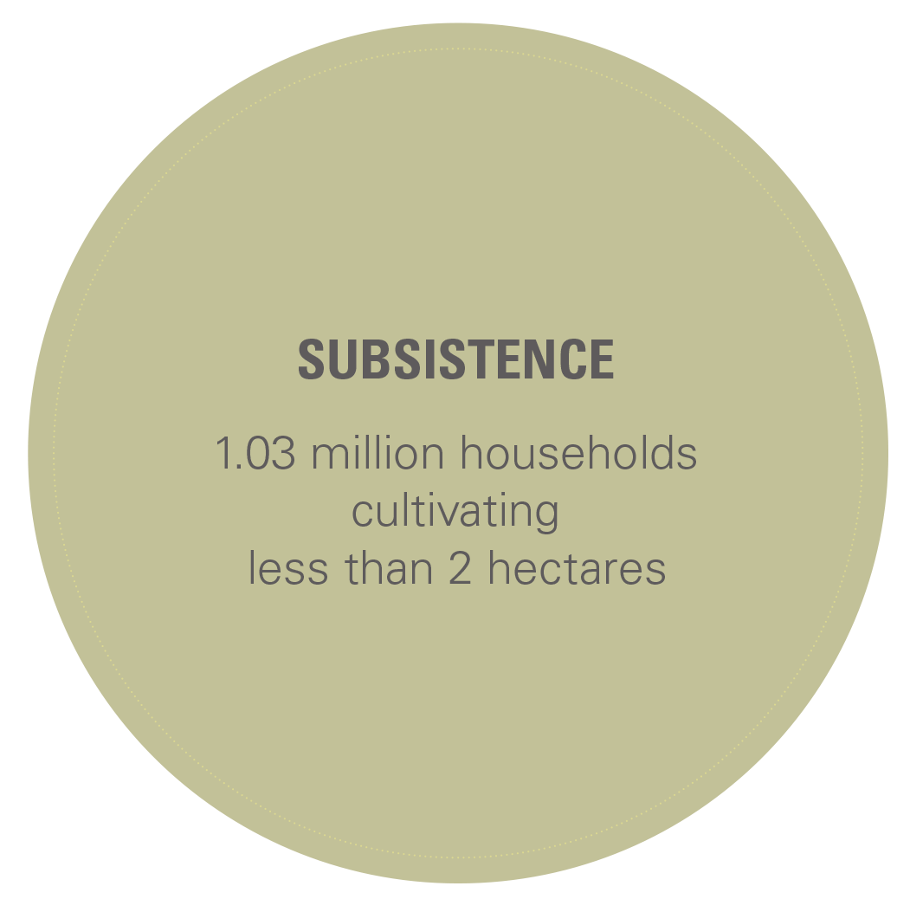
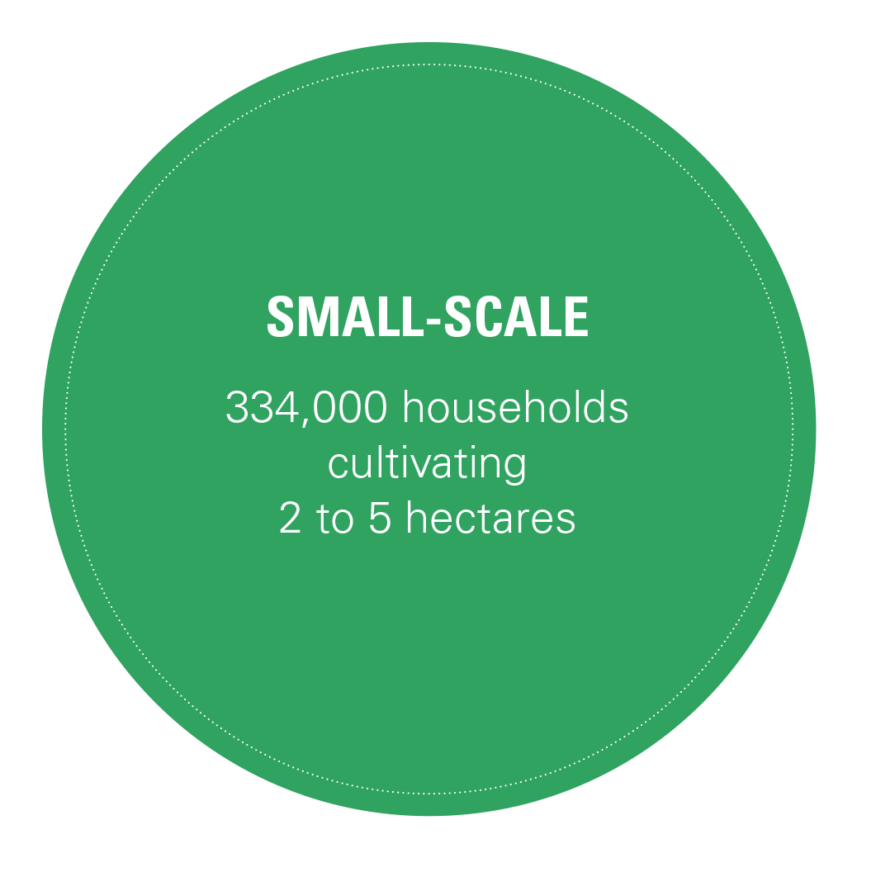
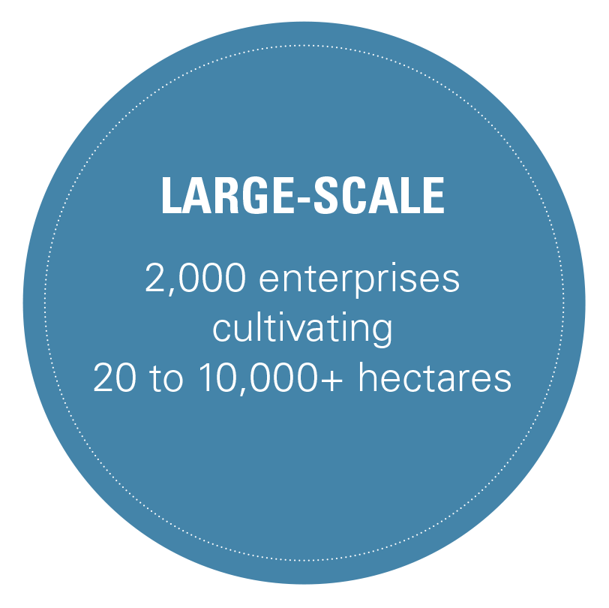
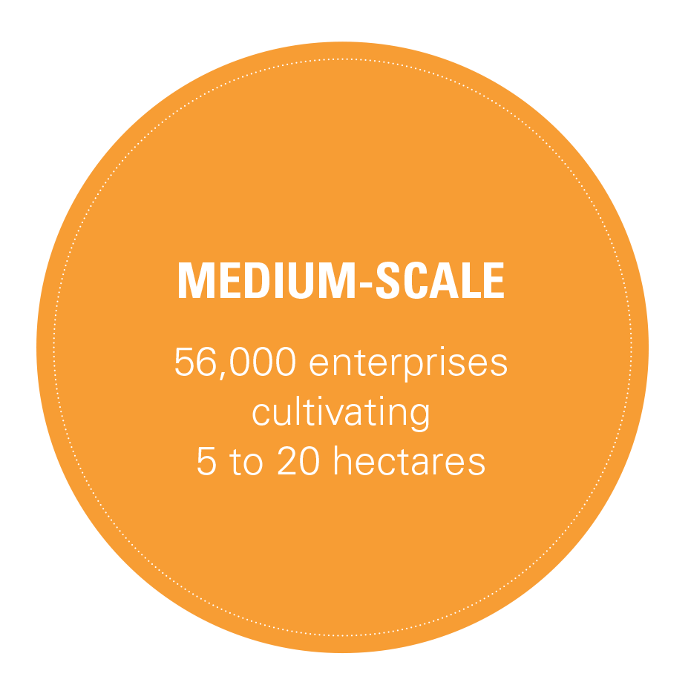
ZAMBIA’S PRODUCERS
Notes:
Ninety-six percent of Zambia’s producers cultivate less than 5 hectares. Most have limited or no access to secure land tenure, improved seeds and fertilizer, irrigation or mechanization. They are net food buyers, who sell into local markets and derive most of their income from wage labor.
Medium-scale farms produce crops primarily for internal markets and are more likely to have tenure and use advanced inputs.
Zambia’s large-scale farms produce for export markets, operating with comparable inputs and technologies to farmers in the American Midwest.

Slide 30
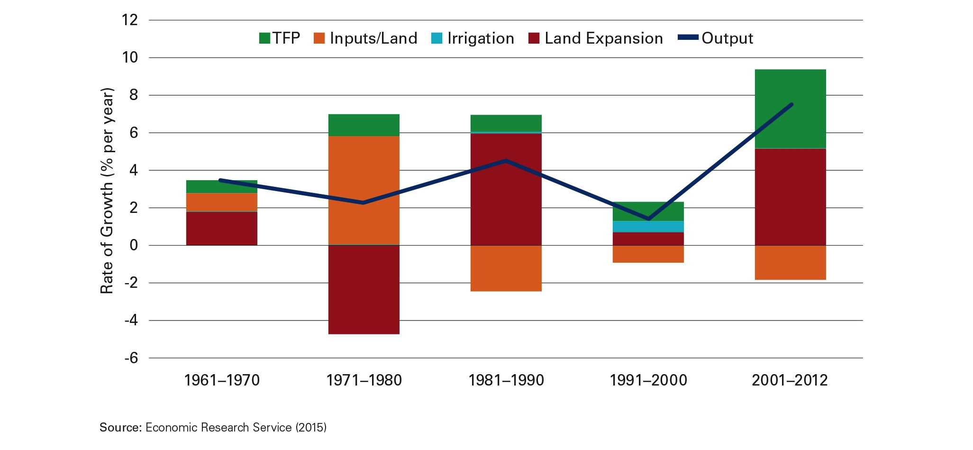
TFP IN ZAMBIA IS ON THE RISE
– WITH ROOM TO GROW
Notes:
Total Factor Productivity has contributed appreciably to Zambia’s growth in agricultural output over the last decade.
Land expansion has also made a significant contribution as tens of thousands of hectares has been put into production.
In the case of maize, Zambia’s major cereal crop, production doubled between 2006 and 2010. Efficiency accounts for 40 percent of the increase — a success story, given that almost all of the increase came from small and medium-scale producers.
At the same time, the land area cultivated for maize increased by 60 percent, making land expansion the primary driver of the increase in maize production.

Slide 31
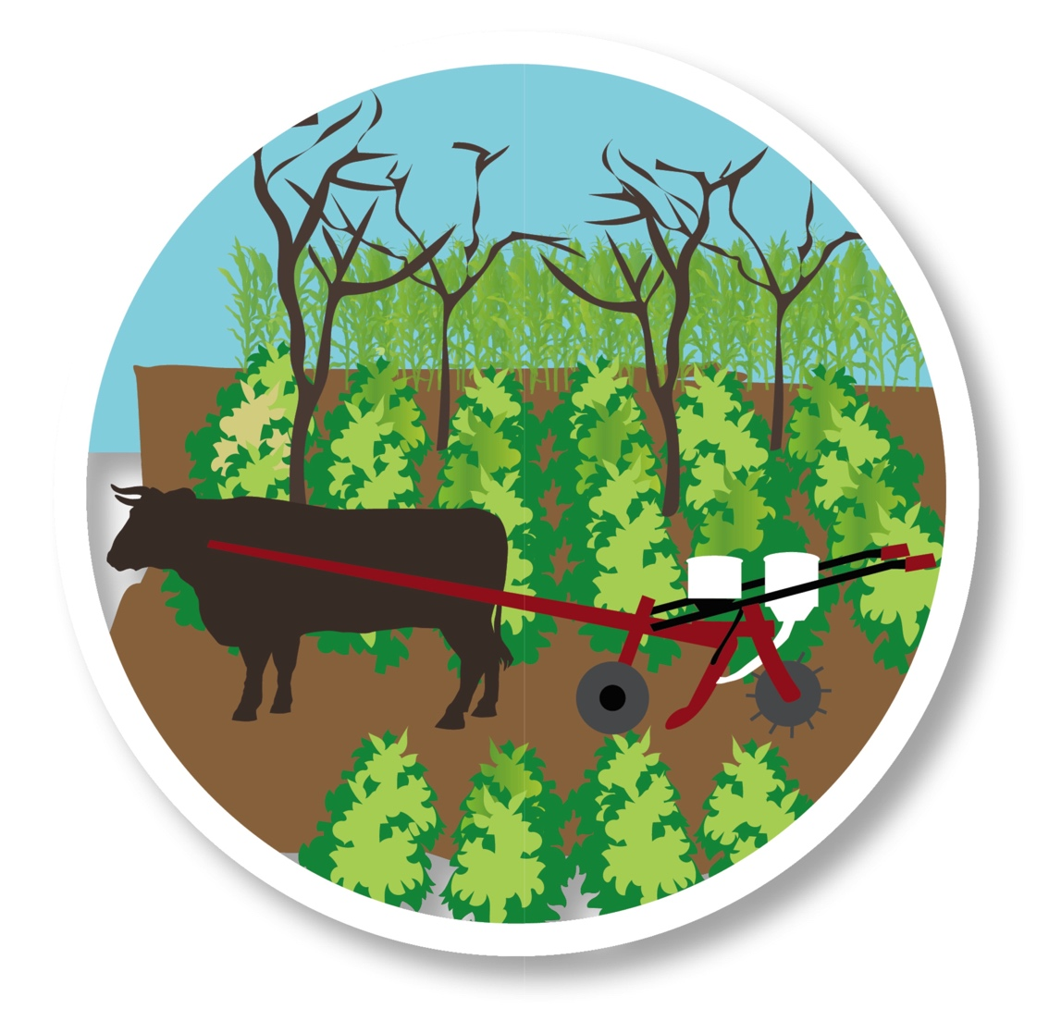
CONSERVATION FARMING
100,000+
Conservation Farmers
in Zambia
Notes:
Zambia has some land suitable for expanding agricultural production, but policies that promote greater productivity on existing cultivated land also need to be prioritized, along with an expansion of conservation farming in fragile and drought-prone regions.
Climate change models predict that over the next 15 years, maize yields in southern Africa could fall by 30 percent due to temperature increases. For many Zambian producers, conservation farming is an effective method for managing climate-related risk.
Currently, more than 100,000 Zambian farmers are practicing some form of conservation farming – more than any other country in sub-Saharan Africa.

Slide 32
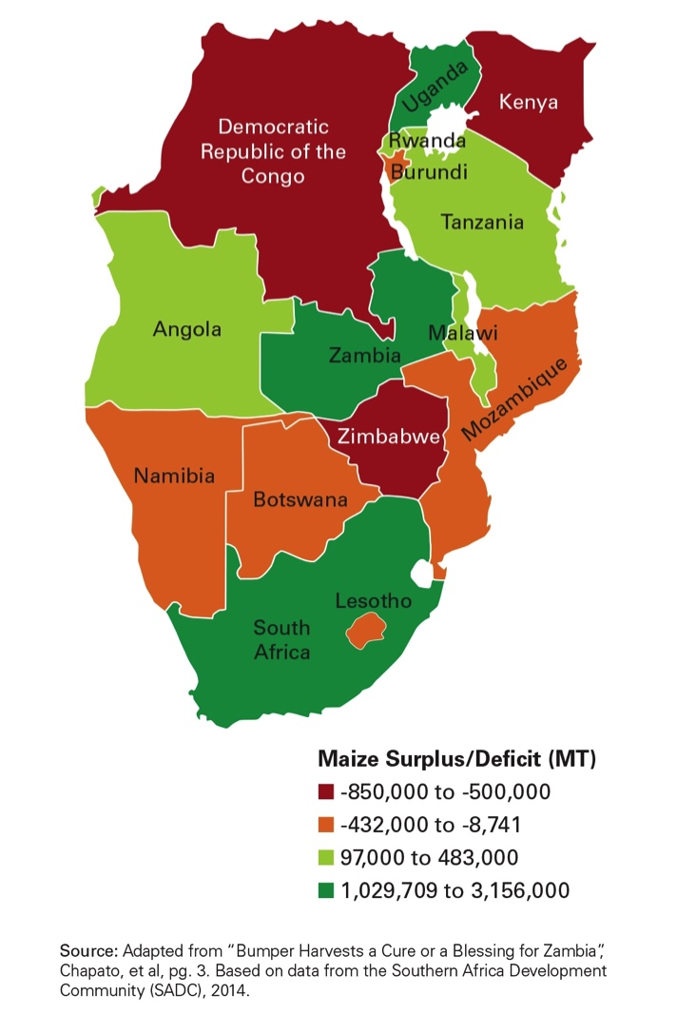
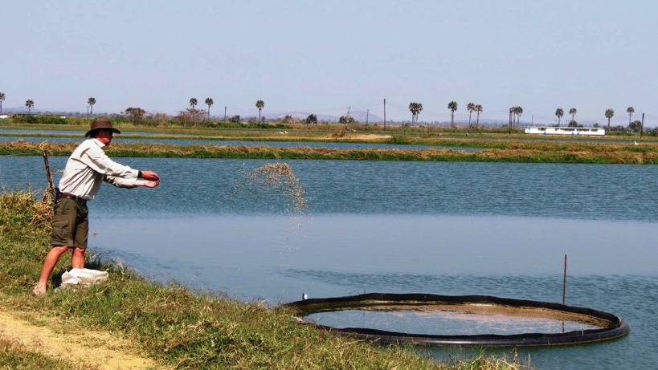
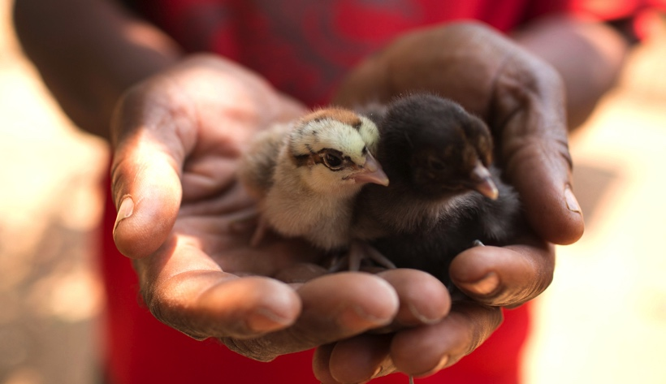
MARKET OPPORTUNITIES
MAIZE
AQUACULTURE
LIVESTOCK
Notes:
The GAP Report highlights several market opportunities for Zambian producers.
Maize is a food staple in every Zambian household. Sixty percent of the calories consumed in Zambia come from maize and domestic animal feed demand is expected to increase 75 percent by 2023. Over the next decade, Zambia should continue to produce surpluses of maize, while its neighbors will have small surpluses or maize-deficits.
Livestock productivity have risen steadily over the last decade, but Zambia still relies on substantial imports to help meet domestic demand for animal protein. Disease is the greatest threat to the Zambian livestock industry and can be particularly devastating to small and medium-scale producers.
Fish are the most commonly consumed source of animal protein by Zambians, particularly in poor rural households. But Zambia has a “fish deficit”: more than one-third of fish consumed in Zambia in 2013 had to be imported. At the same time, only 20 percent of fish production in Zambia is produced sustainably. Increasing sustainable aquaculture production can help Zambia meet its “fish deficit” without putting additional pressure on its already stressed water resources and declining fish populations.

Slide 33
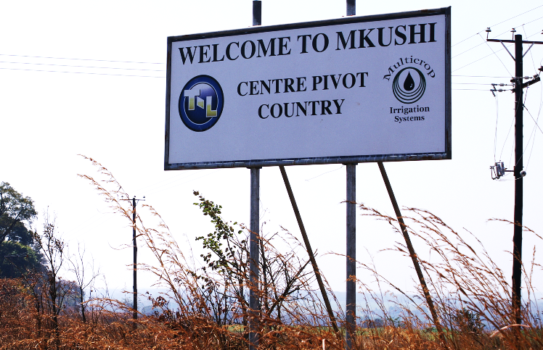
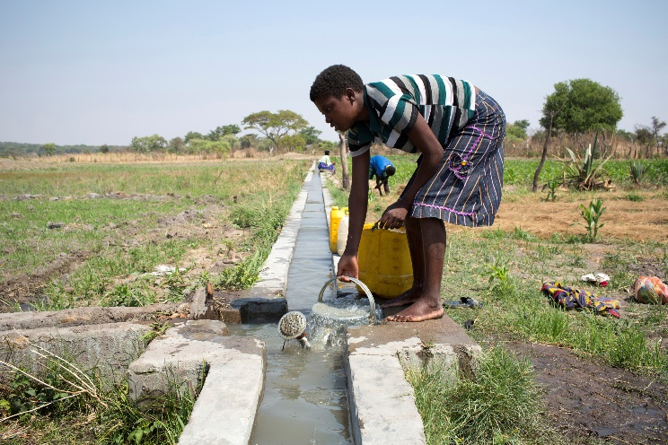
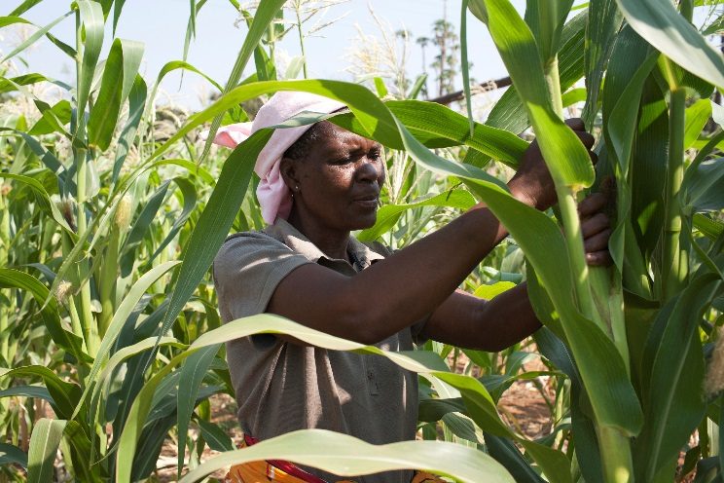
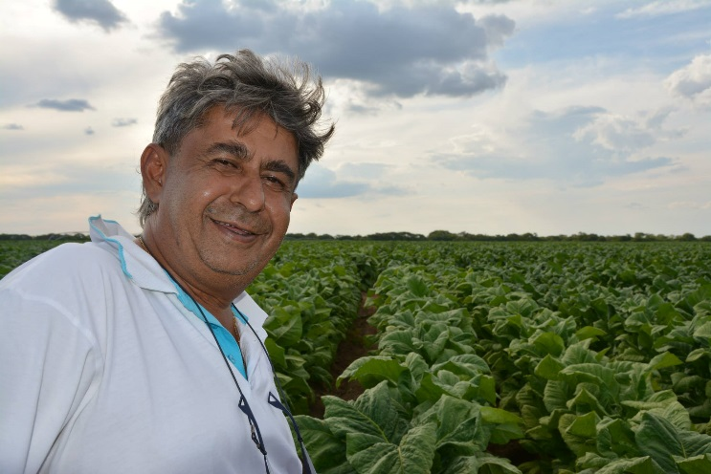
INVESTING IN PRODUCTIVITY
MECHANIZATION
IRRIGATION
IMPROVED SEEDS
HEALTHY SOILS
Notes:
Zambia’s increase in agricultural output and productivity has been driven by farmer investments in productive assets such as machinery, precision agriculture technologies, irrigation systems, fertilizer and improved seeds.
The GAP Report highlights several public-private partnerships that are connecting farmers of all scales with inputs and technologies, as well the knowledge to use them efficiently and the financing to purchase them.
Still, most Zambian farmers are undercapitalized, making it difficult to invest in these technologies.

Slide 34
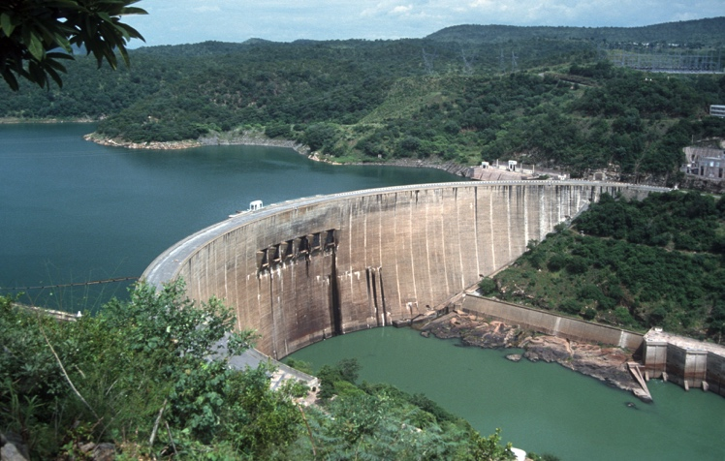
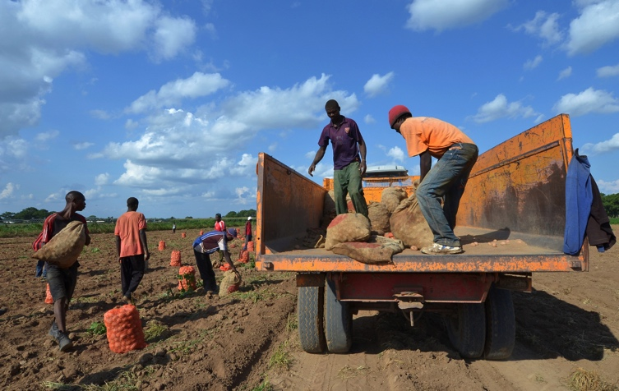
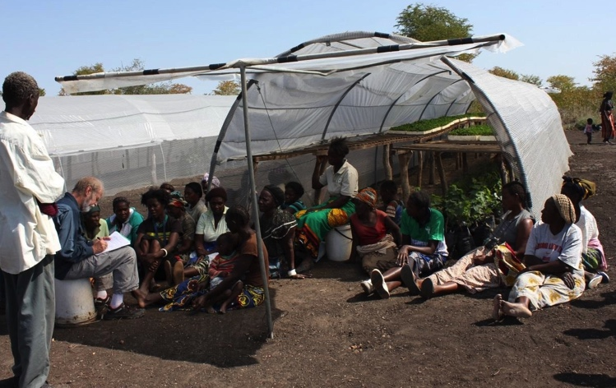
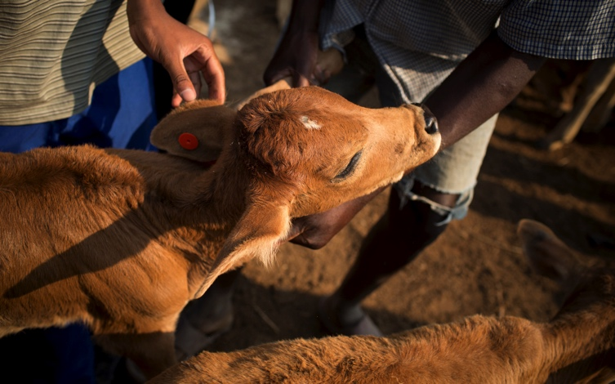
INVESTING IN PUBLIC GOODS
ELECTRICITY
TRANSPORTATION
EXTENSION
RESEARCH
Notes:
Zambian producers – of all scales - want the knowledge, resources and opportunities to make their enterprises more productive, profitable and resilient. Prioritizing investments that stimulate productivity and sustainability is essential. This includes:
Ensuring that farmers of all scales, particularly women, have access to secure land tenure.
Extending and improving the infrastructures for transportation, electricity and irrigation, as well as access to financial systems
Investing in research and extension to develop and transfer agricultural knowledge.
Reducing bureaucratic barriers and harmonizing regulations to increase trade and market development.

Slide 35




SUCCESS STORIES
WOMEN & YOUTH
CONSERVATION
COTTON PRODUCTIVITY
VALUE CHAINS
Notes:
The president of the Zambian National Farmers Union said recently, “Farming is not a lifestyle; farming is a business, and…the same factors that affect any other business affect farmers. Farmers need access to knowledge and skills, access to education. That way we will be able to make sure our farmers are not subsistence farmers only, but have a livelihood and can produce food. We need to be profitable.”
The GAP Report highlights several case studies that are helping achieve these goals and enabling Zambia to become a sustainable breadbasket for southern Africa.

Slide 36
BUILDING BLOCKS FOR
SUSTAINABLE DEVELOPMENT
Notes:
Undergirding all these actions is a real need to focus on the Building Blocks for Sustainable Development: the Policies that lead to sustainable production and reduction of loss and waste. Since 2009, GHI has advocated 5 strategic policy goals, including Investing in public agricultural research, development and extension: embracing science-based and information technologies, and scaling up efforts to get them in the hands of farmers; involving the private sector in agriculture and infrastructure development; removing barriers to regional and global trade in agriculture; and strengthening and coordinating international development assistance and productive safety nets for nutrition. The 2015 GAP Report highlights the key policy steps that must be taken in the USA and Zambia to create more sustainable breadbaskets in each country and to help meet food security needs.

Slide 37

EMBRACE INNOVATION, EXPAND PROGRESS
Notes:
Biotechnology is a toolbox of many diverse molecular and genetic techniques allowing us to sustainably provide food, feed, fiber and biofuels. Agricultural biotechnology increases crop and livestock yields and can help improve nutrition in countries where production is hampered by harsh environmental conditions and a lack of modern agricultural tools and technologies.
At the inaugural FAO Biotechnology Symposium in February, 2016, Director General of FAO, Graziano da Silva stated, “It is time to discuss and analyze what agricultural biotechnologies have to offer.” FAO has initiated a groundbreaking conversation to explore how the rapidly emerging, broad-based field of agricultural biotechnology can complement agro-ecological approaches to sustainably increase productivity, especially for smallholder farmers.

Slide 38
“TAKE IT TO THE FARMER”
Dr. Norman Borlaug

Slide 39
BUILDING SUSTAINABLE BREADBASKETS – TOGETHER
Notes:
Thank you!

